Slide 1
Training Ship golden bear
Cadet cruise meeting #1
CSU Maritime Academy
Cruise 2024
Sept. 14, 2023

Slide 2
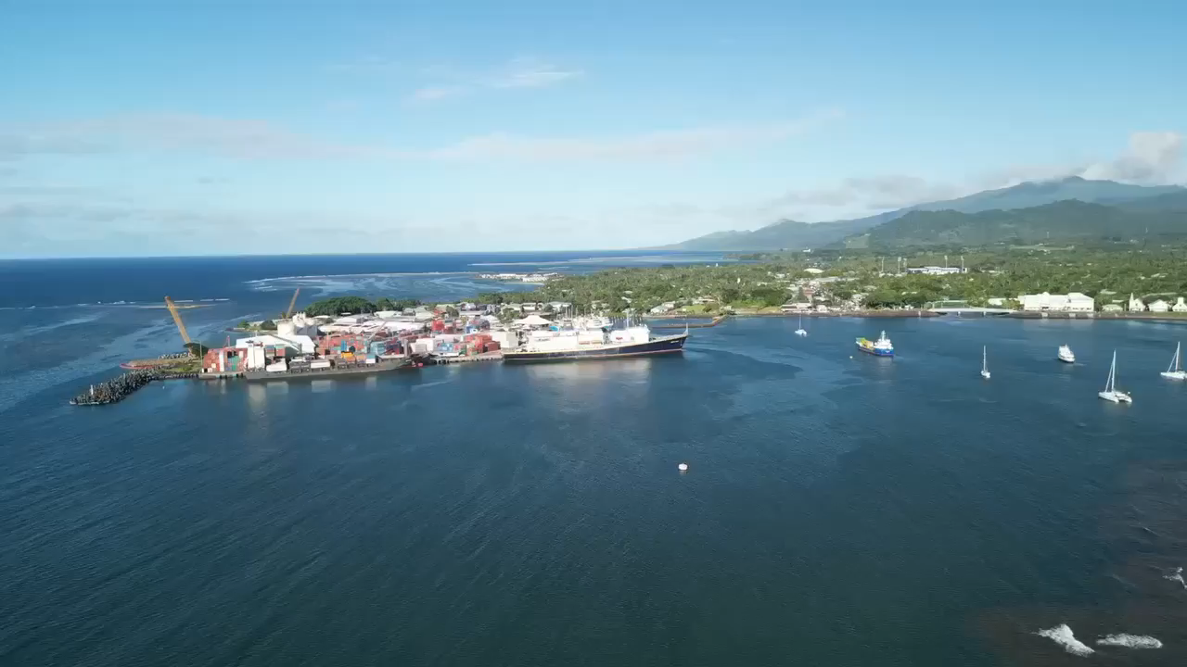
WELCome to csu maritime academy

Slide 3
Congratulations on picking a unique and awesome school for your education
CSU Maritime Academy is unlike any other CSU and offers an exceptional education and experience
One of those experiences is cruise!

Slide 4
Summer Training cruise
Each summer we embark on one (sometimes two) cruises
We visit a mix of international and US ports
We bring anywhere from 250-300 cadets and 50-60 crew
Cruise is an opportunity for cadets like you to:
  Earn sea time to put towards your licenses
  Practice the valuable technical skills you’ve learned throughout the academic year
  Experience traveling internationally (fulfills graduation requirements)
  Exercise leadership skills acquired from your work assignments and responsibilities with the Corps of Cadets
All hands work seven days a week on cruise – but we do our best to make it a fun and memorable, irreplaceable experience!

Slide 5
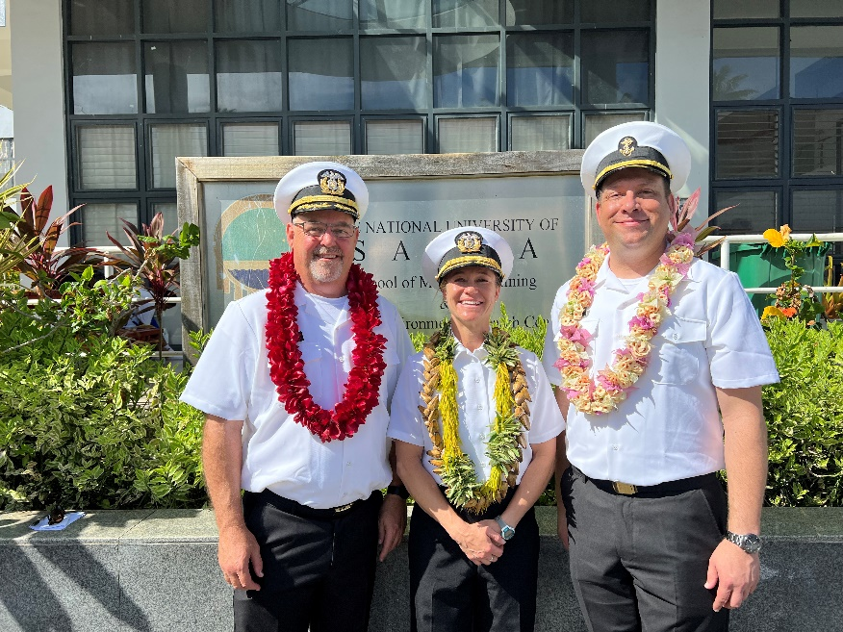
Meet the tsgb crew
& cruise leadership
Captain Samar Bannister – Cal Maritime c/o 2000
Chief Engineer Adam Kleitman – Cal Maritime c/o 2012
Chief Mate Doug Nagy – Cal Maritime c/o 1989
Commandant Jimmy Moore – Cal Maritime c/o 2010
2nd Mate Chelsea Martin – Cal Maritime c/o 2011
2nd Engineer Dan Nichols Cal Maritime c/o 2014
Bosun Anders Bland
Logistics Officer Lisa Warner
Purser Jessica Fowler
There is a reason many of us have returned to serve our alma mater – we believe in this program, and we believe in you, our cadets!

Slide 6
Captain bannister’s
4 rules for success
We want to ensure that everyone has the amazing cruise experience they deserve!
To make this happen, the Captain has four rules that everyone must abide by:
COMMUNICATE
DO THE JOB
TREAT EVERYONE WITH RESPECT
BE SAFE

Slide 7
    The vessel’s crew is already preparing for cruise, both habitability and regulatory wise
    What does this mean?
    We are getting the ship ready for all of you to live aboard the TSGB for two months next summer!
    There is some maintenance to be done to prep the ship, and a lot of paperwork too…

Slide 8
General awARENESS
However, we welcome you to come aboard and get familiarized with your future temporary home
When coming aboard the ship, we ask that you:
bring a photo ID (port pass), wear close-toed shoes, sign in and sign out
And always remember to keep one hand on the ship – use those handrails when walking up and down stairs!!
But most importantly…..

Slide 9
When using the toilets on the ship:
PLEASE DO NOT FLUSH ANYTHING THAT HAS NOT COME FROM YOUR BODY OR IS NOT APPROVED AND PROVIDED TOILET PAPER ☺
No body wipes
No feminine products
No rags/paper towels
TS Golden Bear is an older vessel and has sensitive plumbing. Please help us prevent major plumbing problems by being conscious of these guidelines.

Slide 10
CALLING ALL SENIORS
We (the ship's crew) are holding you all to a higher standard as this is your senior cruise
We will raise our expectations gradually throughout the academic year to prepare you to be leaders among your underclassmen as you have sailed on the TSGB before
We will rely on you to set a good example for your peers – so please do your best!

Slide 11
Cruise requirements
Before the fun begins and you are cleared to move aboard for cruise, there are some tasks you must accomplish:
Pass your pre-requisite courses
Earn your required credentials - Lifeboatman, Basic Safety Training (BST), Security Awareness or Vessel Personnel with Designated Security Duties (VPDSD)
Furthermore, you must have a Cal Maritime Port Pass, Transportation Worker Identity Credential (TWIC), Passport, and MMC for upperclassmen

Slide 12
You are required to have a valid, unexpired TWIC and Passport to sail
  Passport cards are not allowed – Passport books are required
  If you do not have a TWIC or Passport yet – apply for them NOW
  If your Passport or TWIC are expiring before or during 2024 cruise, start the renewal process NOW as it can take months to receive these documents
TWIC and Passport must be valid through August 2024 and you must have the physical document with you on cruise
We will start collecting copies of these documents in November 2023

Slide 13
Berthing
You will have one locker and one drawer assigned to you to hold all of your belongings for your two-month cruise – pack wisely and be conscious of space
Bulky and flammable items are restricted per USCG CFR 116.423 – please leave your down comforters, fluffy rugs, and thick bedding at home

Slide 14
Schedule
We do not have our schedule or itinerary yet, but we are working hard to get it solidified and should have it ready soon
Once it is decided, we will publicize this information
Thank you for your patience ☺

Slide 15
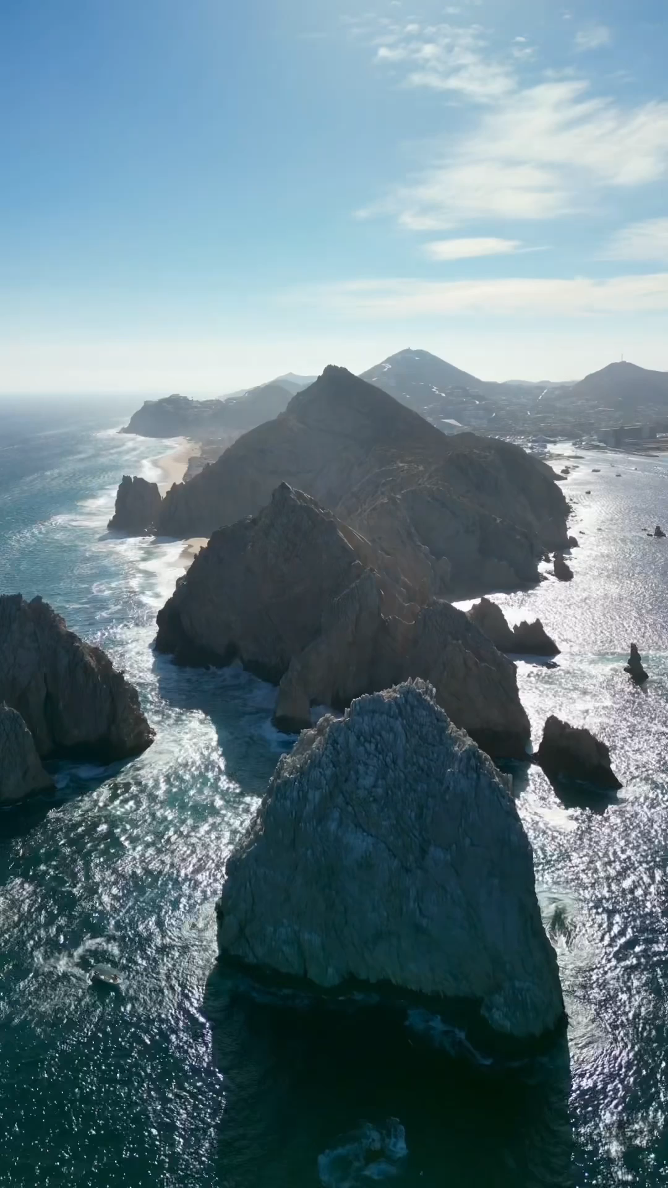
THANK YOU
FOR YOUR TIME AND COOPERATION!
We are excited to have you all aboard for CRUISE 2024

