Slide 1

Training Ship Golden Bear
Summer Cruise 2024

Slide 2
Sick Bay on TSGB
Grace Chou, MD
Director of Student Health Services

Slide 3
Sick Bay
Location: 01-deck, aft house, portside. Counseling office is similarly
      located on starboard side
Hours: At Sea: 0815 – 1700*
    *Closed for lunch 1200 – 1315
    In Port: 0815 – 1015
    Counseling: Hours vary as posted on office door
    Clinic Phone: Ship ext. 1366

Slide 4
Medical & Counseling Staff
 | Month 1 | Month 2
Chief Medical Officer | Rebecca Miller, MD | TBD
Medical Officer | TBD | Mark Caplin, PA
Counselor | Erin Currie, PhD | Miriam Anthony, MFT

Slide 5
Medical Emergencies Underway and in Port
Medical staff is available 24-hours a day/7 days per week while ship is at sea or in port
Contact the bridge and speak to on-duty licensed watch officer to access medical staff after-hours
Anyone with a fever must report to sick bay immediately
If on-shore medical care is required you will be sent to the next in-port medical center and will need your personal health insurance, cash or credit card for payment
Use sick bay early rather than late.
Confidentiality is maintained for all health care.

Slide 6
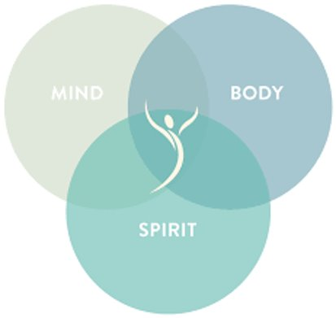
Counseling and Psychological Services (CAPS)
Integrated Health Care
We are here to help you with your physical and mental health to help you enjoy your time at Cal Maritime and to achieve your goals!

Slide 7

Confidentiality
Confidential?
The health care provided to Cal Maritime students is CONFIDENTIAL in accordance with FERPA, HIPAA and other applicable state and federal laws.
Students’ medical information is accessible only to the Health Center’s professional staff and will not be released without written authorization from the student, via a lawfully issued subpoena, or for public health reasons.
Students must give their consent before ANY information can be released to family or others.

Slide 8

Coast Guard Licensing and Mental Health
The USCG does not require waivers or restrict licensing for mental health concerns that are well controlled.
You may take anti-depressants, ADD/ADHD medications, seek counseling or other mental health care and this will not impact licensing. If you have any concerns or questions, ask us.

Slide 9
COVID-19/Influenza
If you develop fever, cough, shortness of breath or any symptoms consistent with COVID-19 or influenza, please contact medical staff immediately.
Diagnosis: we have point of care testing that can provide a rapid antigen result in 15 minutes for COVID-19 and influenza.
If you are immunocompromised or at high risk for complications of COVID-19 and influenza, it is highly recommended that you fill and carry a supply of Paxlovid

Slide 10
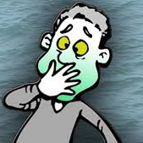
Motion Sickness
Seasickness
Mal de Mer
Start anti-motion sickness medication 48 – 72 hours prior to departing to allow time for your body to adjust to side effects.
Starting dose of meclizine 12.5 mg daily can help reduce side effects.
Seabands can be used with or without medication and should be purchased on your own from a local drug store prior to cruise.
Dramamine, bonine, and ginger can also help.

Slide 11
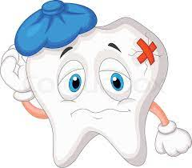
Dental Care
Make sure you are up to date on dental care including checkups and any needed dental work.
Having a dental problem at sea without a dentist on board is not ideal.

Slide 12

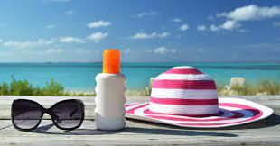
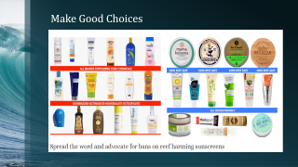
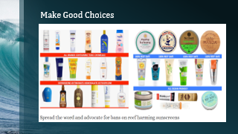
Heat and Sun Exposure
Avoid sun between 1000 and 1400
Wear protective clothing/hats and sunglasses
Drink lots of fluids, avoid alcohol
Always use lip balm and sunblock (or sunscreens and with UVA and UVB sun protective factor of at least 15).

Slide 13
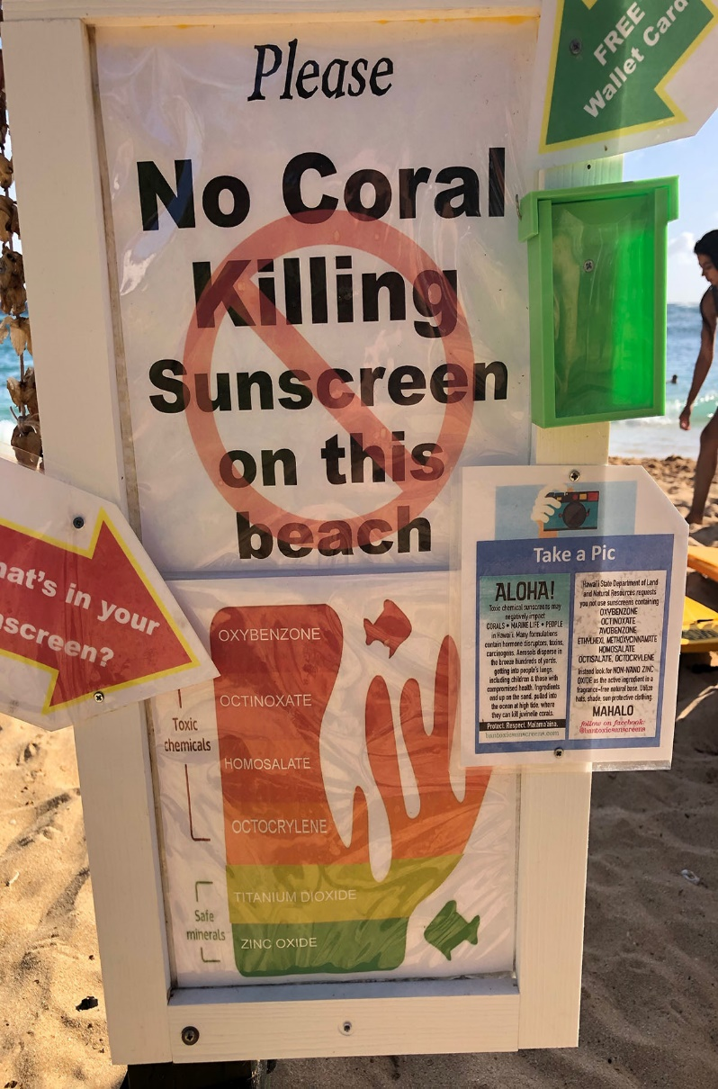
Reef-safe Sunscreen
Check the label! Make sure your sunscreen does not contain the following harmful substances:
Oxybenzone
Octinoxate
Octocrylene
Homosalate
4-methylbenzylidene camphor
PABA
Parabens
Triclosan
Any nanoparticles or “nano-sized” zinc or titanium (if it doesn’t explicitly say “micro-sized” or “non-nano” and it can rub in, it’s probably nano-sized)
Any form of microplastic, such as “exfoliating beads”

Slide 14
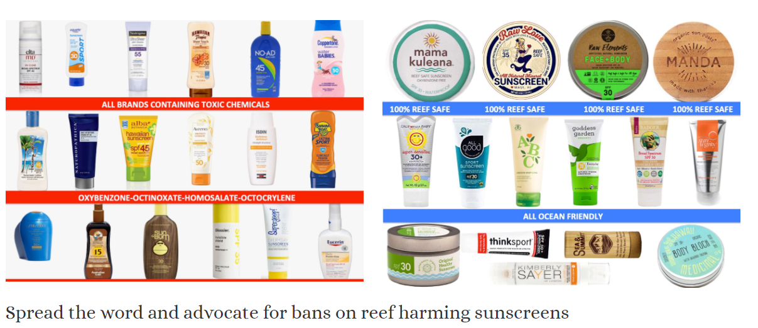
Make Good Choices

Slide 15
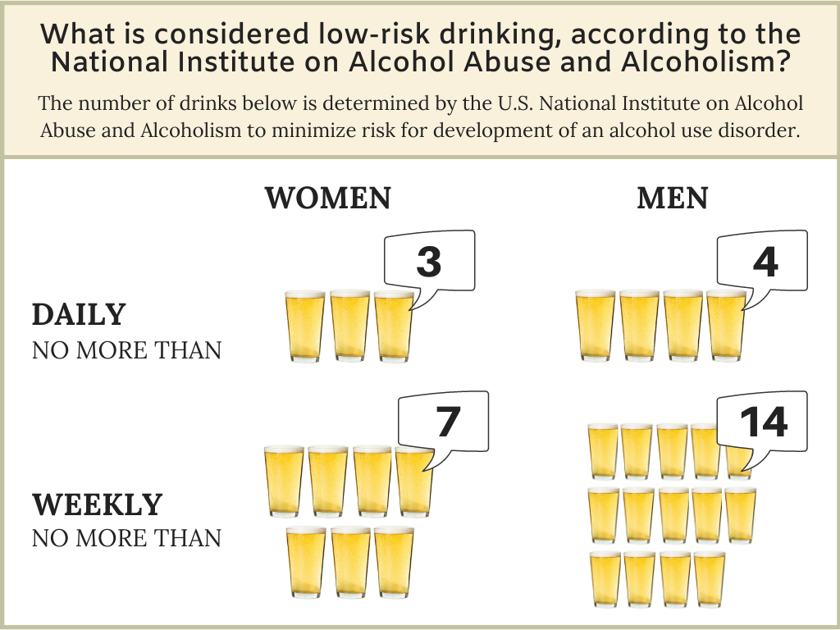
The Most Common Reason Cadets Don’t finish Cruise: Alcohol-related Injuries

Slide 16
Alcohol: Guidelines for Responsible Drinking
Immediately report any concerns to medical staff if you know of a shipmate who may be over-intoxicated as alcohol poisoning can be fatal.
Eat before drinking to slow down alcohol absorption.
Limit how much you drink and drink slowly. Keep track of how many drinks you have consumed.
Do not leave beverages unattended and do not take any beverages from someone you don’t know well and trust. Avoid open container drinks including punch bowls.

Slide 17
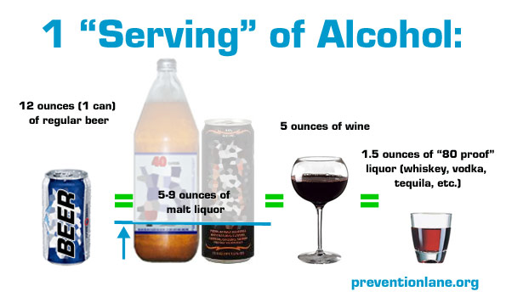
Leave No Sailor Behind
Watch out for friends. Anyone appearing disproportionately intoxicated in relation to alcohol they have consumed may have had a tampered beverage.
Party in groups and never leave a party without accounting for those you came with. ALWAYS pre-plan a safe ride back to the TSGB.
Know how alcohol affects you.
Do not mix alcohol with other drugs as this may be dangerous.

Slide 18
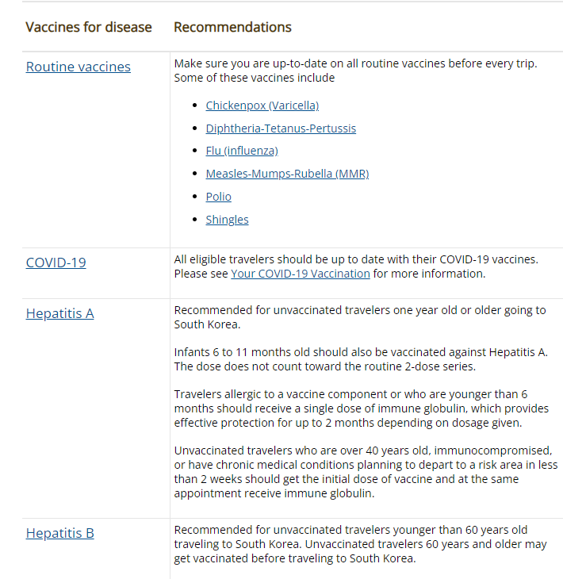

CDC Recommendations for Travel to South Korea & Japan

Slide 19
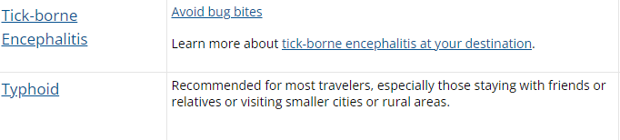

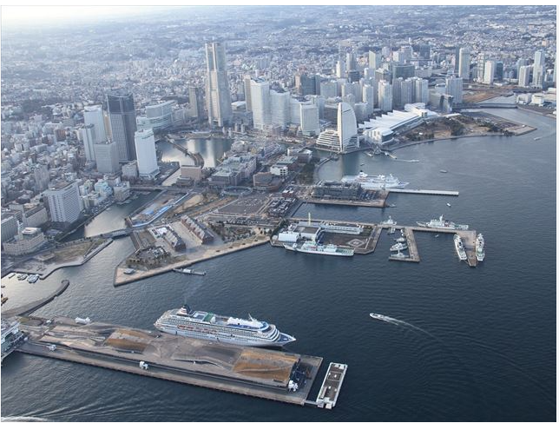
CDC Recommendations for travel to South Korea and Japan (continued)

Slide 20
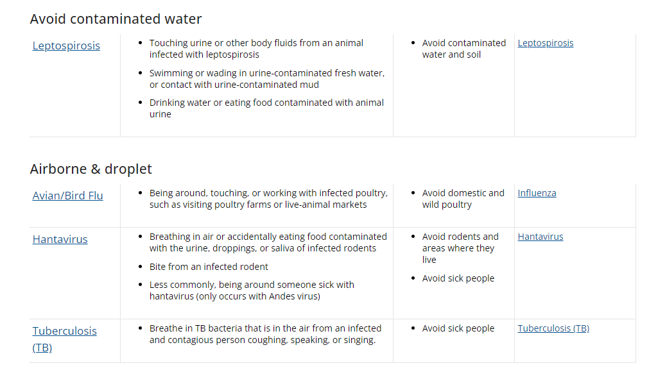
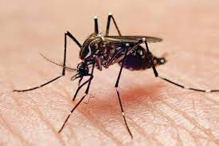
Non-vaccine-Preventable Diseases

Slide 21
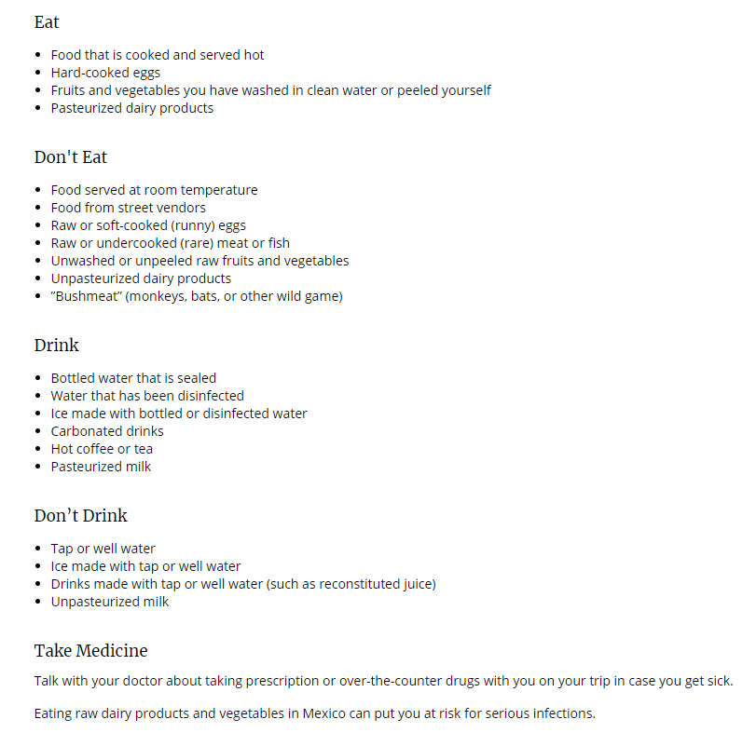

CDC Recommendations
Eat and Drink Safely

Slide 22

Stay Healthy and Safe
Prevent bug bites
Stay safe outdoors
Keep away from animals
Reduce your exposure to germs
Avoid sharing body fluids
Select safe transportation: Motor vehicle crashes are the #1 killer of healthy US citizens in foreign countries.

Slide 23
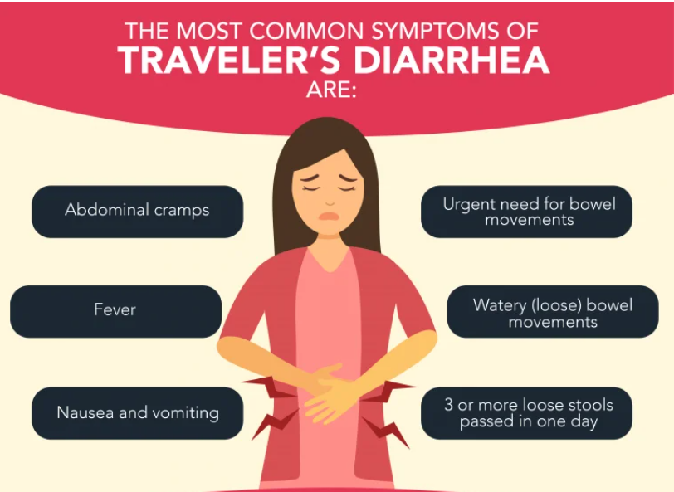
Traveler’s Diarrhea

Slide 24
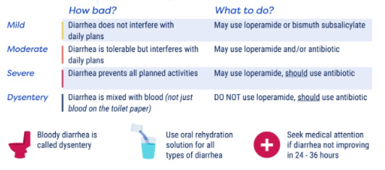
Traveler’s Diarrhea

Slide 25
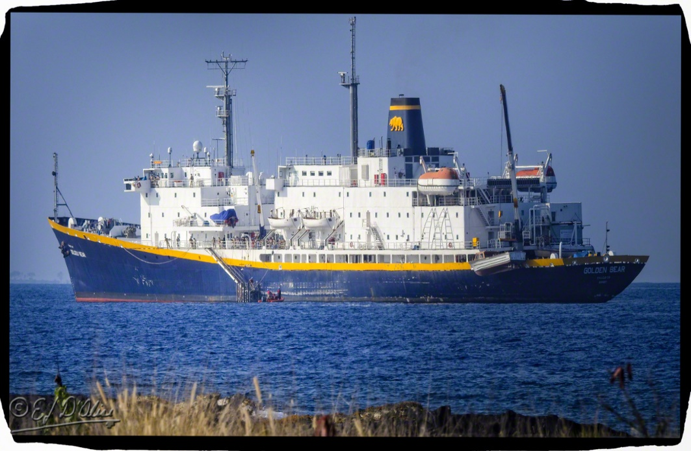
Questions???
Student Health Center
Phone: 707.654.1170
Email: StudentHealth@csum.edu

Slide 26
Mental Health at Sea
Bear Cruise Edition
Spring 2024
Presented by Ian Wallace, PhD
Prepared by Miriam Anthony, AMFT

Slide 27


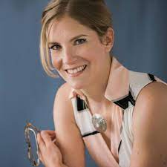
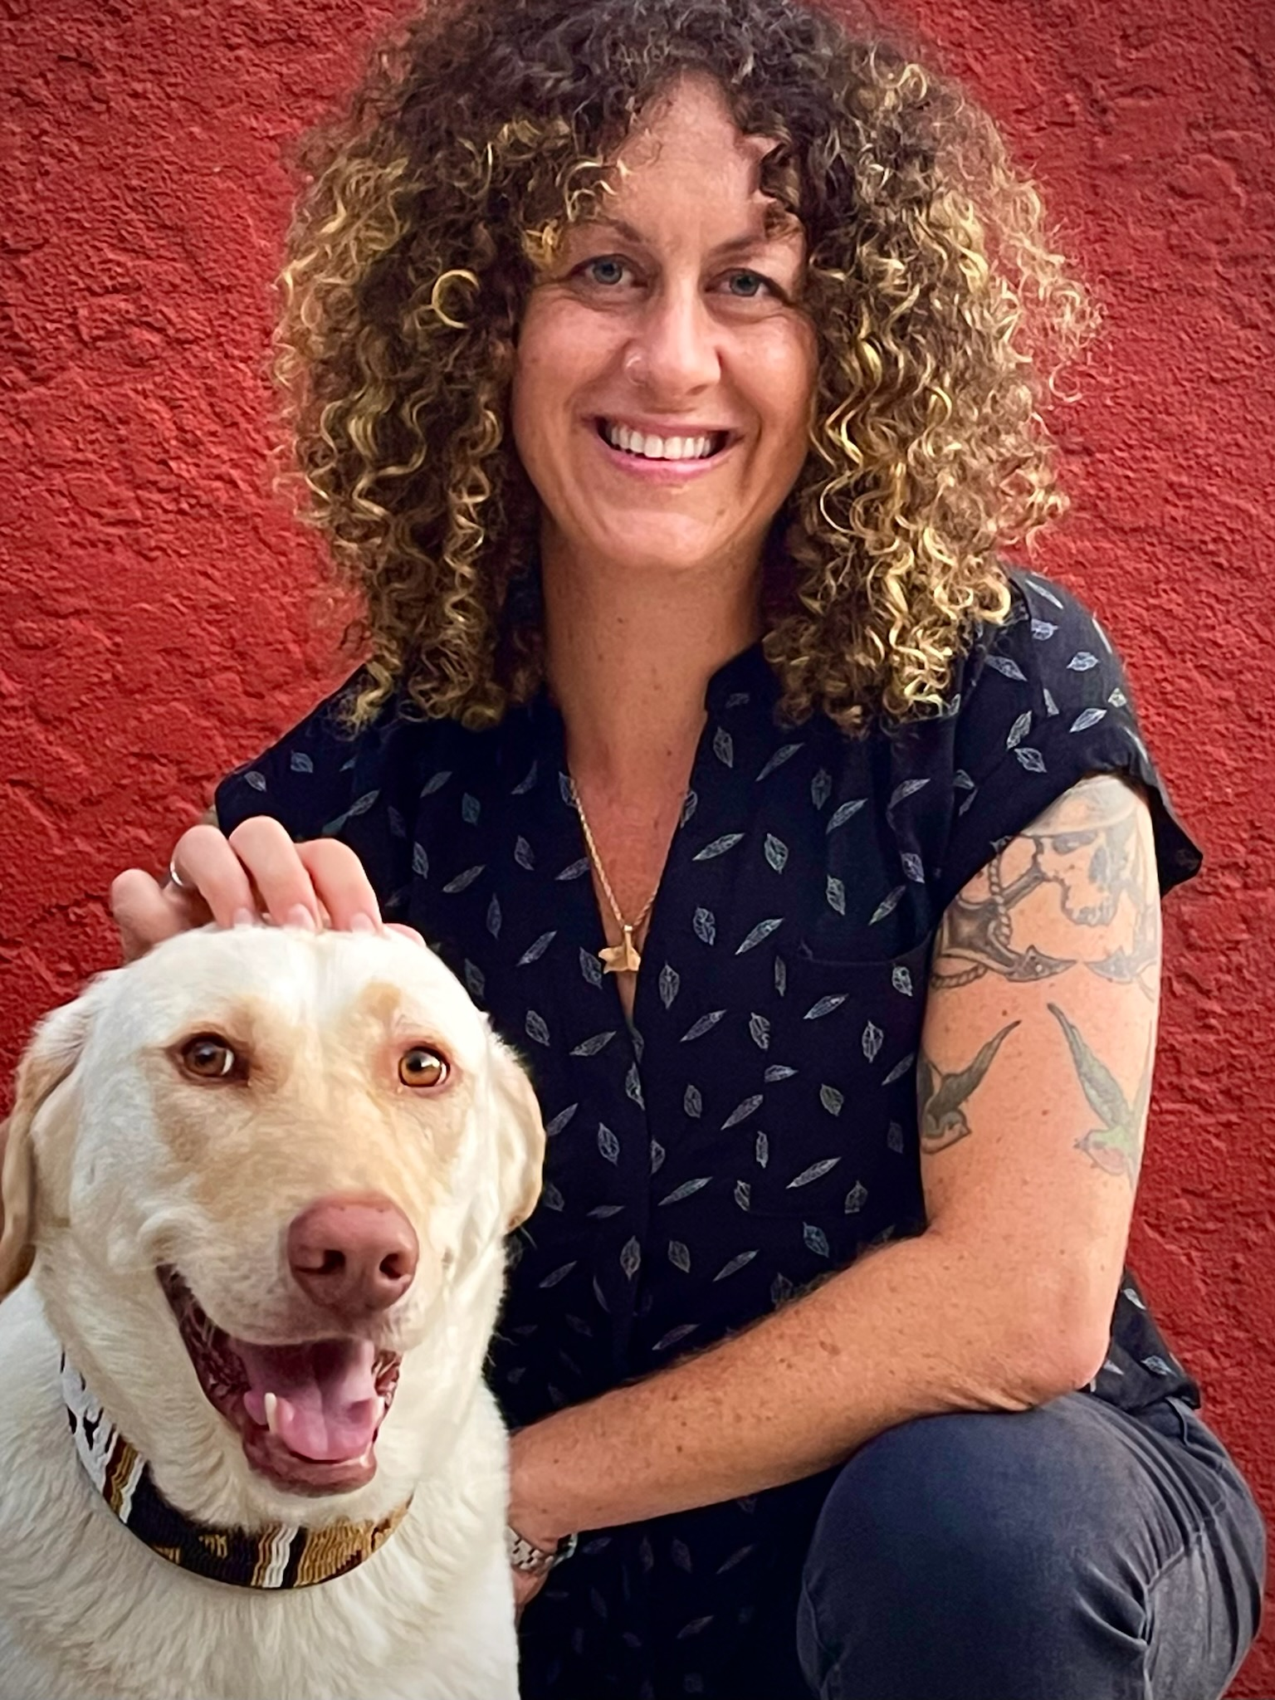
WHO ARE THESE PEOPLE?
CAPS COUNSELORS
Dr. Ian Wallace is a licensed Psychologist and has been working with cadets on the training ship and on campus since 2013. Dr. Wallace is the director of CAPS and currently serves on several committees and boards on the CSUM campus.
Dr. Erin Currie is a Professor at the University of Portland. She specializes in anxiety management, trauma recovery, and academic skills development.
As a team, we work to advocate for cadets and research ways to improve mental health on campus and at sea.
Marie Ekmekjian is a Licensed Professional Clinical Counselor and Certified Rehabilitation Counselor who has been working with college students for over 8 years and with experience in providing mental health and vocational rehabilitation services to veterans and individuals with disabilities.
Miriam Anthony has been sailing for over 15 years, holds a Chief Mate license, and has sailed all over the world on various types of vessels. Now an Associate Marriage and Family Therapist, she joined CAPS last year as a counselor, and sails on Summer Bear Cruise (dog not included).

Slide 28
So, you are going to sea! What about your Mental Health?
How to prepare for Bear Cruise
Stressors at sea
Once you are out there: Navigating and maintaining
SIGNS!
When it feels like too much
Self care and supporting others
You have options and resources (Professional Resources and Support)
Real life examples
Questions????

Slide 29
How to Prepare for and Adjusting to Life at Sea
Bring some comforts from home such as blankets, coffee mugs, books, journals, pictures, room décor, lucky hat, whatever might keep you grounded in a new environment.
Prepare for staying in touch with home if you anticipate being homesick. Writing emails, calling, texting, sending postcards, etc.
Bring things you know will ground you – musical instruments, your favorite snacks, movies on a hard drive, etc.

Slide 30

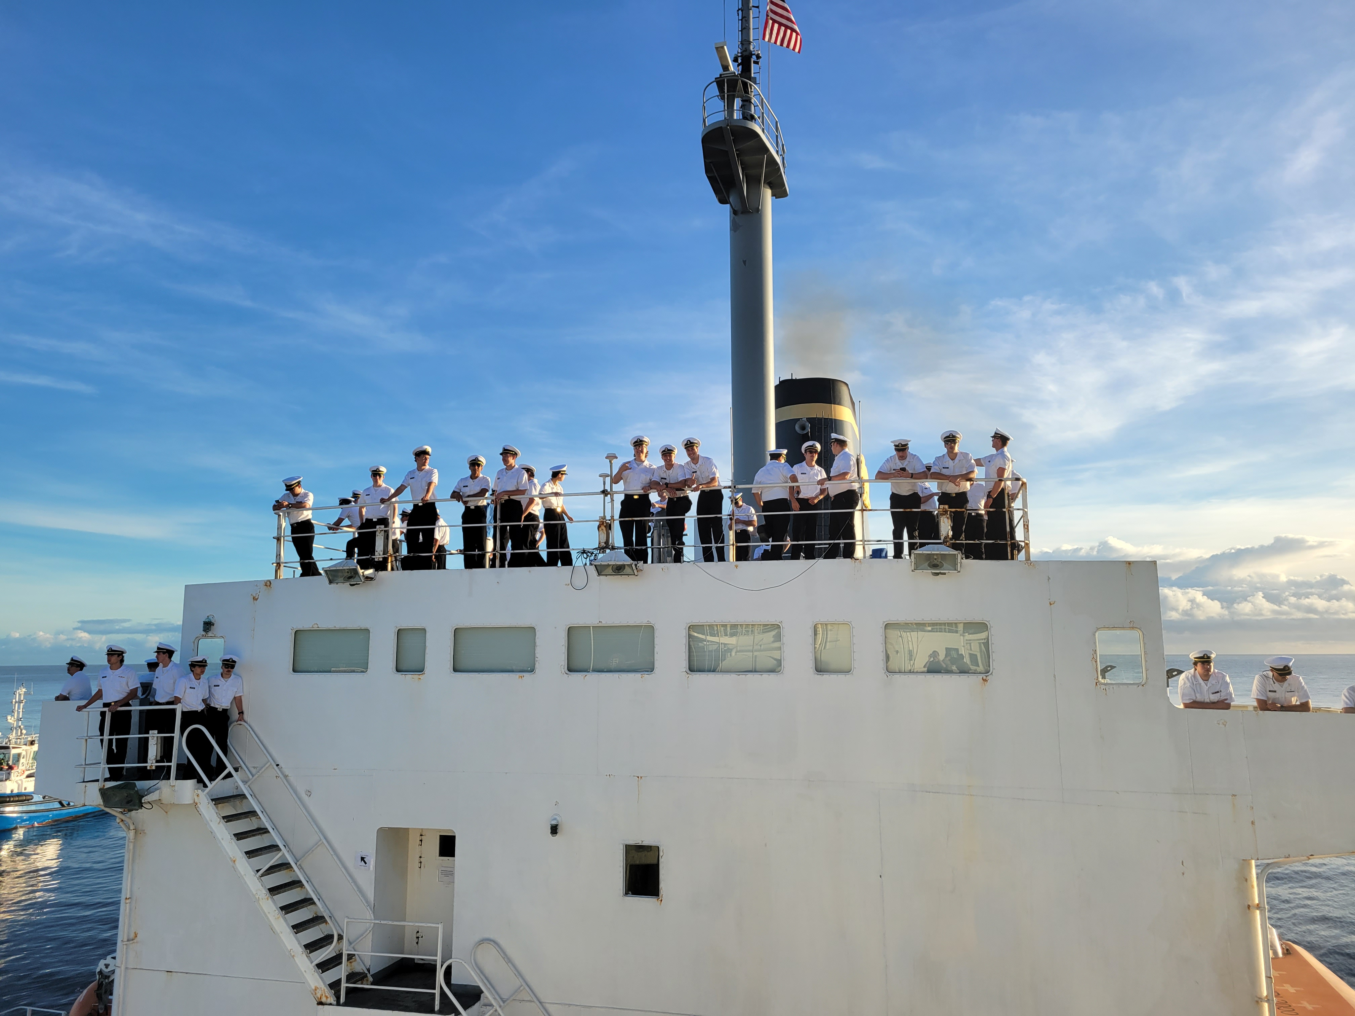
Stressors on Bear Cruise
Close and Cramped Quarters
Long Work Hours/days underway
Isolation
Fatigue
Boredom
No Internet or Phone
Academic Stress
Traumatic Incidents
Ship-board Culture
Poor Sleep or Sleep Interruptions
According to a 2022 survey*, mariners are most stressed by being away from family, followed by money and workload.
Know the signs of depression and anxiety so you can check-in with yourself and your shipmates (next slide)

Slide 31
Possibly the most common stressors on the Bear are social exhaustion (and loneliness)
The Bear is cramped. It is not easy to escape the company of others. For some, this is fun. For others it is annoying and exhausting.
Signs:
If you are feeling irritable, impatient, or if you're no longer finding joy in those social engagements that you used to find joy in, you may be socially exhausted.
Emotionally exhausted
Feel like you’re having a melt-down.
Feel anxious or depressed.
Difficulty sleeping
Inability to focus.
Self Care.
Set social boundaries with others.
Meditate, read or find something you can do alone on deck, in the library, in a classroom or elsewhere on the ship that is relaxing for you.
It is possible your roommates are feeling it too, so setting a time for everyone to have 20-30 minutes alone in the room might be beneficial to all.

Slide 32
Once you are Out there
Show up, try to stay present. You might start to worry about things back at home or ruminating about past experiences while you are at sea. That’s ok, but try to stay in the moment. You’re on a ship, working with a team, and learning invaluable skills, having incredible experiences- BE THERE.
If you are lonely, call someone.
If you are angry, drink some water or listen to music.
Check-in with other cadets and ship-mates.
Get on a routine and sleep schedule.
HAVE FUN!
Get your projects DONE ASAP.

Slide 33
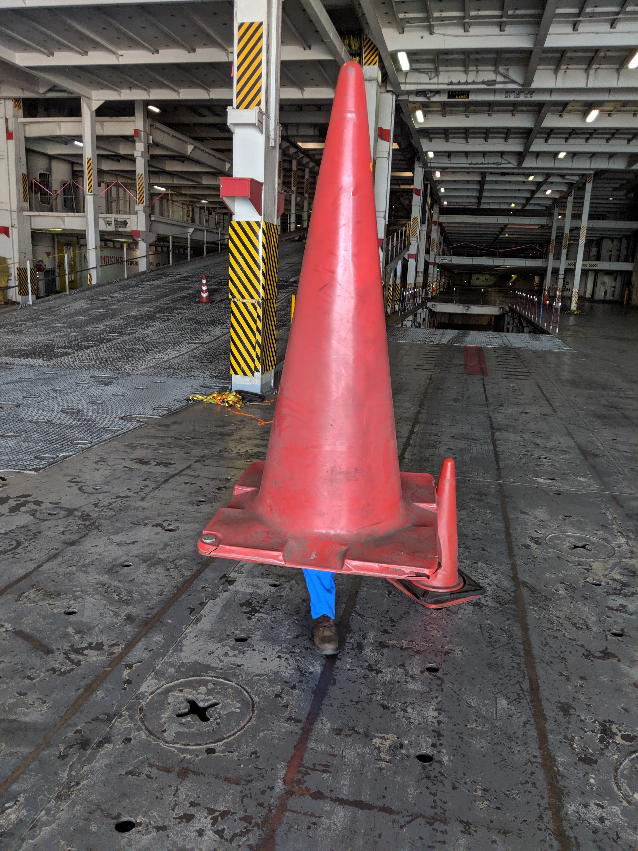

Signs you May be Depressed or Anxious
You are isolating yourself from others.
Hard time sleeping or oversleeping.
You are feeling down, depressed or hopeless.
Poor Appetite or Overeating.
Little interest in doing things.
Feeling bad about yourself or feeling like a failure, or that you have let yourself or your family down.
Thoughts that you’d be better off dead.
Excessive worry about the past or future.
Intrusive thoughts
Feeling overwhelmed
Feeling of impending doom (like something bad is going to happen).
Trouble concentrating or making decisions
Feeling irritable, tense or restless.
Having heart palpitations or panic attacks
Experiencing nausea or abdominal pain.

Slide 34

Navigating and Maintaining
Deck
Stressed Out Sailors
Engine
Stress, Anxiety and Depression can affect anyone on the ship.
Think of your mental health like navigating and maintaining a ship. You need to make a voyage plan, have a contingency plan, and be ready to react when you encounter other ships or inclement weather.
Expect isolation, fatigue, and academic stressors.
At the same time, your mind is like the machinery that you are maintaining. Engaging in self-care is like adding oil or cleaning filters.

Slide 35
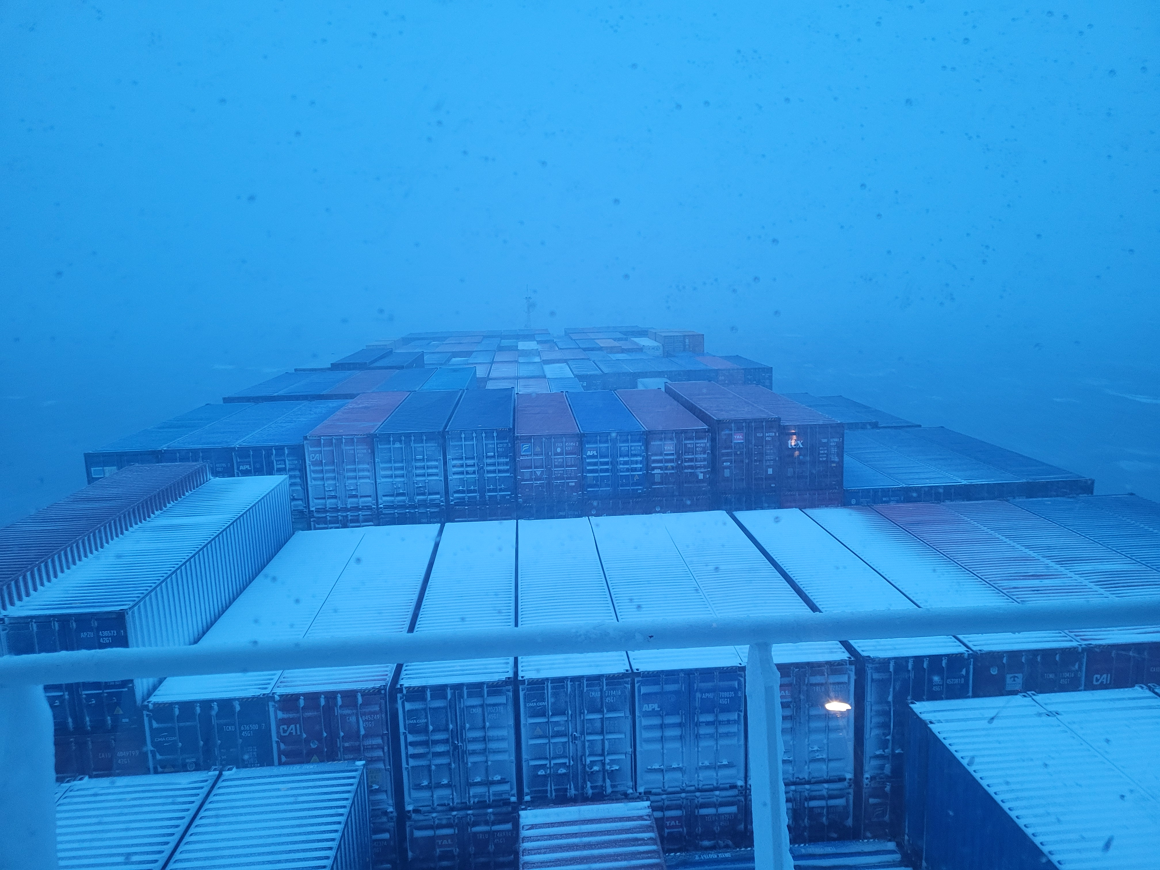
When it Feels like Too Much

Slide 36

Self Care and Supporting Others
Self Care can be anything you do that alleviates your stress and anxiety.
Reading a book, calling a friend, journaling, working out, watching the sunrise/sunset, hanging out with shipmates (hello, karaoke), hydrating, getting a massage/haircut/manicure, playing or listening to music, making art, sunbathing, and napping are all ways to care for your mental health- just to name a few.
Supporting shipmates and friends is easy!
Reaching Out:
  “HOW ARE YOU?”
  It is OK if your cruise sucks- it doesn’t last forever (thank goodness).
  Listen to your shipmate, reassure them that they aren’t alone.
  Offering support and connection, or suggesting they reach out to CAPS or another trusted mentor.

Slide 37
You Have Options when Feeling Overwhelmed
Download Mood Management, Self-Help, Fitness, Music, Meditation, or other Apps before you set sail.
Make sure the apps work when offline.
Good Apps Include:
  Nike Training Club, Fitness Buddy, Home Workout
  Headspace, Calm, Meditation Assistant
  Spotify (has audio books now)
  Emoods
  ISWAN for Seafarers, Maritime Wellbeing
Reach out to the CAPS counselor, your friends, div coms, or instructors.
Reach out to mentors, friends, family for love and support.

Slide 38
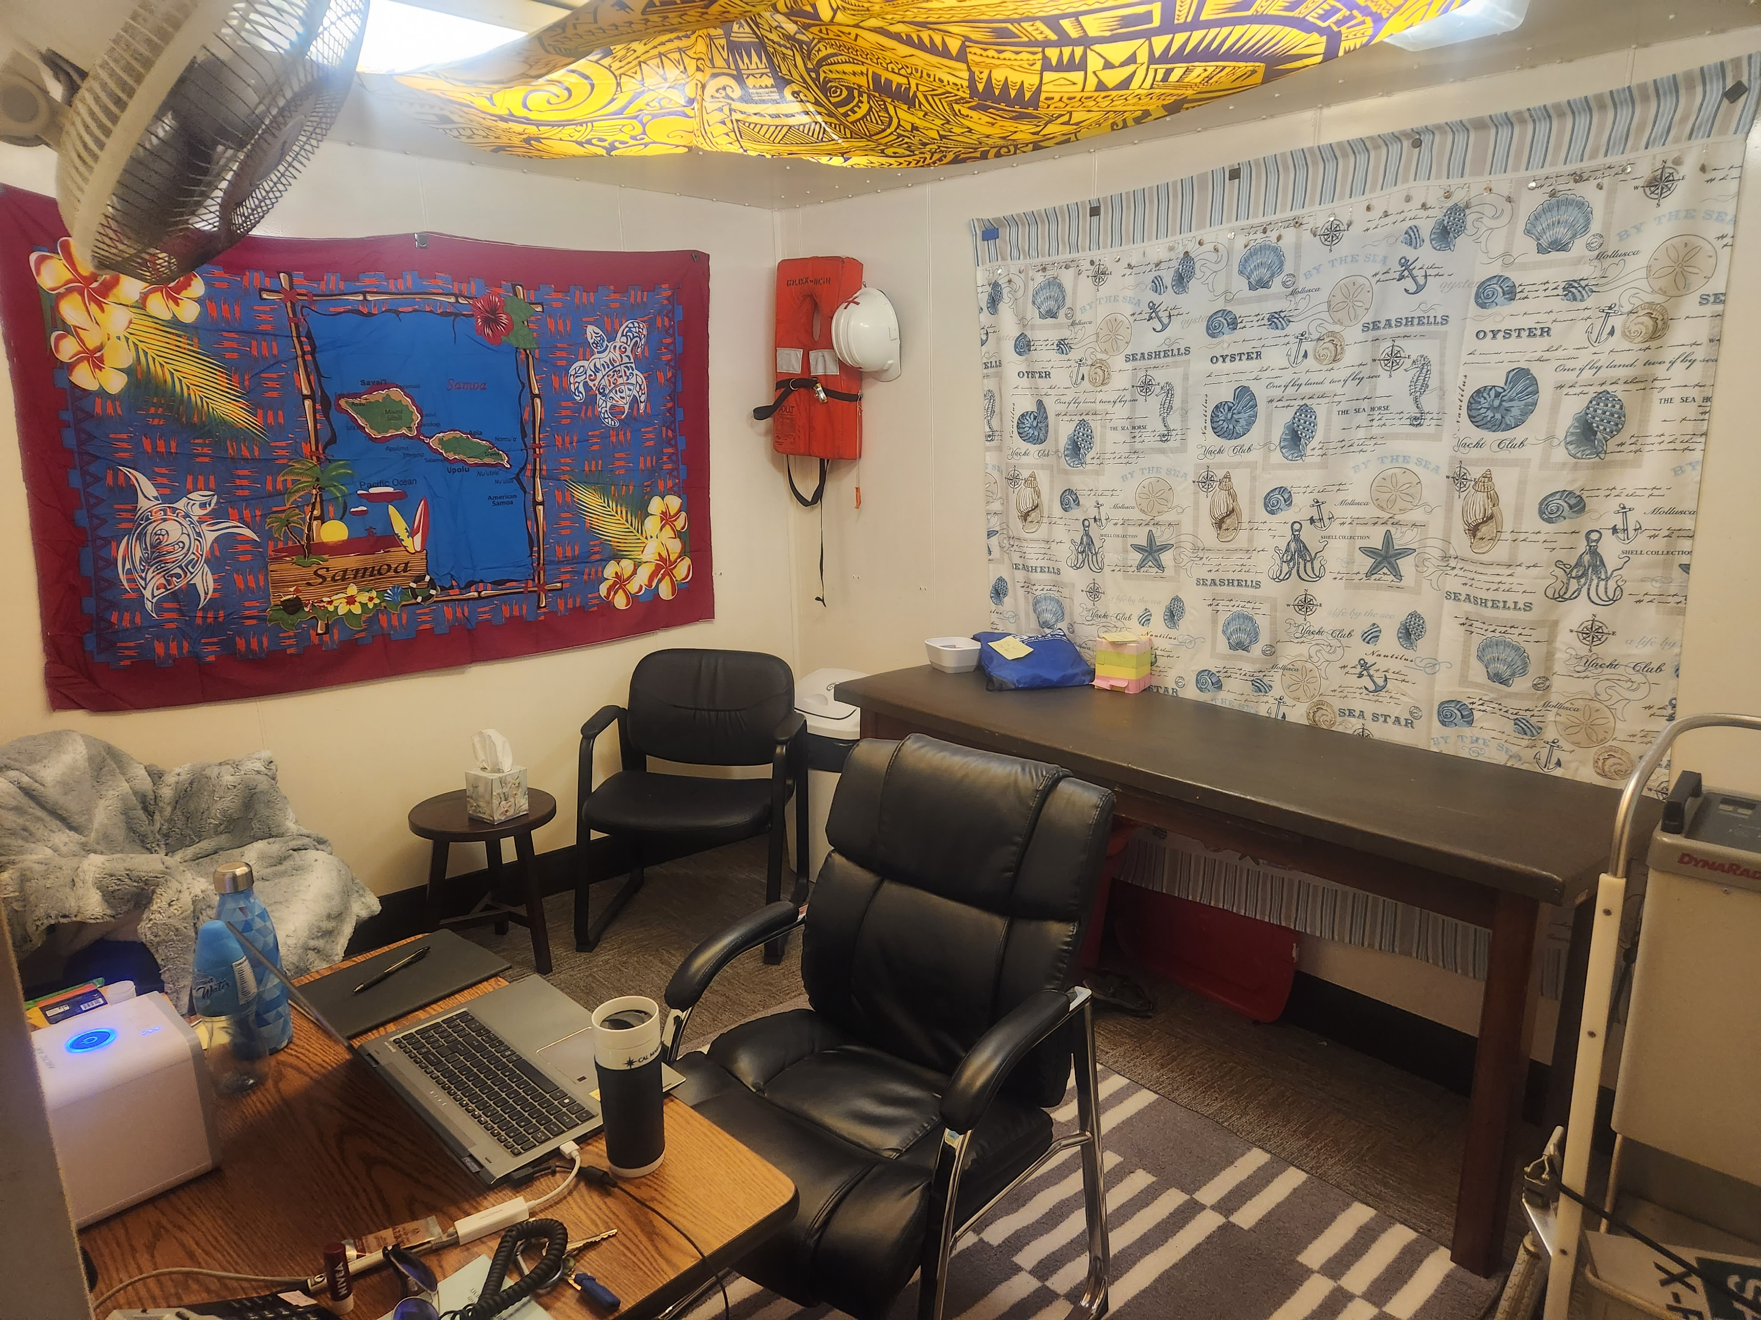
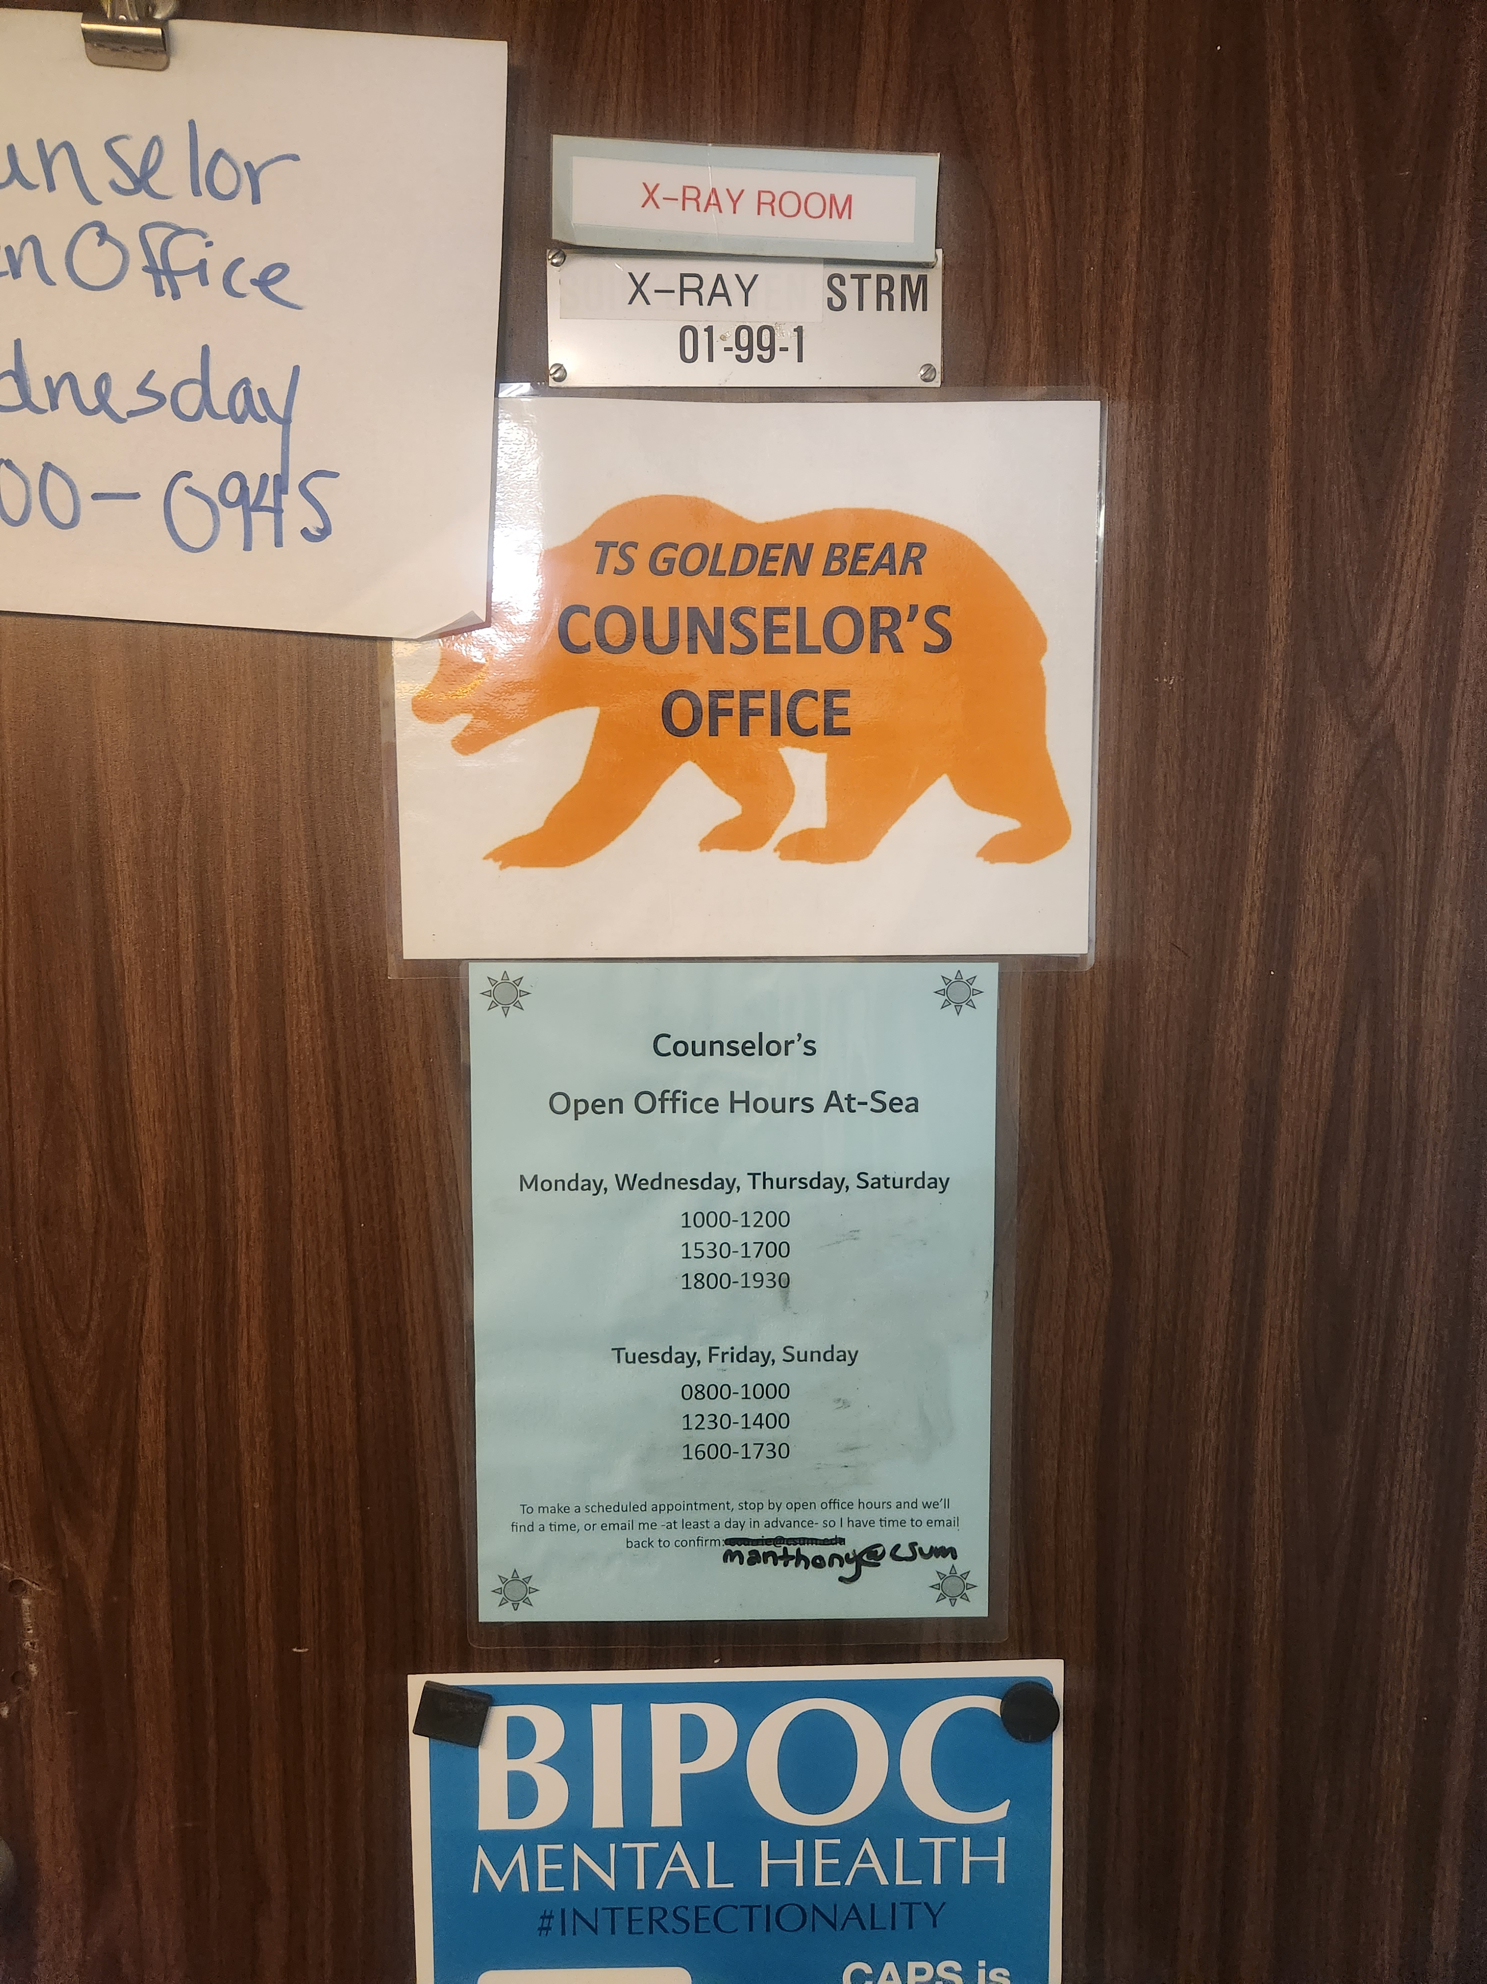

COUNSELING OFFICE ON THE BEAR main deck (01), midship, starboard

Slide 39
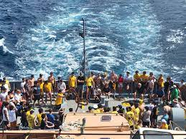
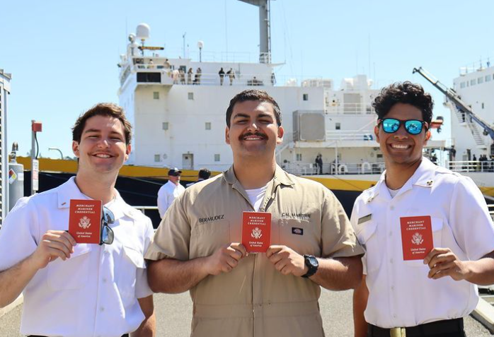
DID WE MENTION HAVE FUN?!
Cruise is a right of passage, required for graduating, and getting licensed.
When things are tough on the Bear, remember – it is temporary! And once you have your license in your hand, it will all have been worth it.

Slide 40

CASE STUDY 1: A Couple work on Boundaries
Randy and Steph had been together for 6 months.
  They were on cruise together, in the same division.
  Randy found himself worrying where Steph was when they weren’t together.
  Steph wanted to spend time with her girlfriends who were in a different division, and needed to be alone at times.
  Randy and Steph came to the CAPS counselor on cruise and were able to communicate their needs and worries in couple’s counseling.

Slide 41
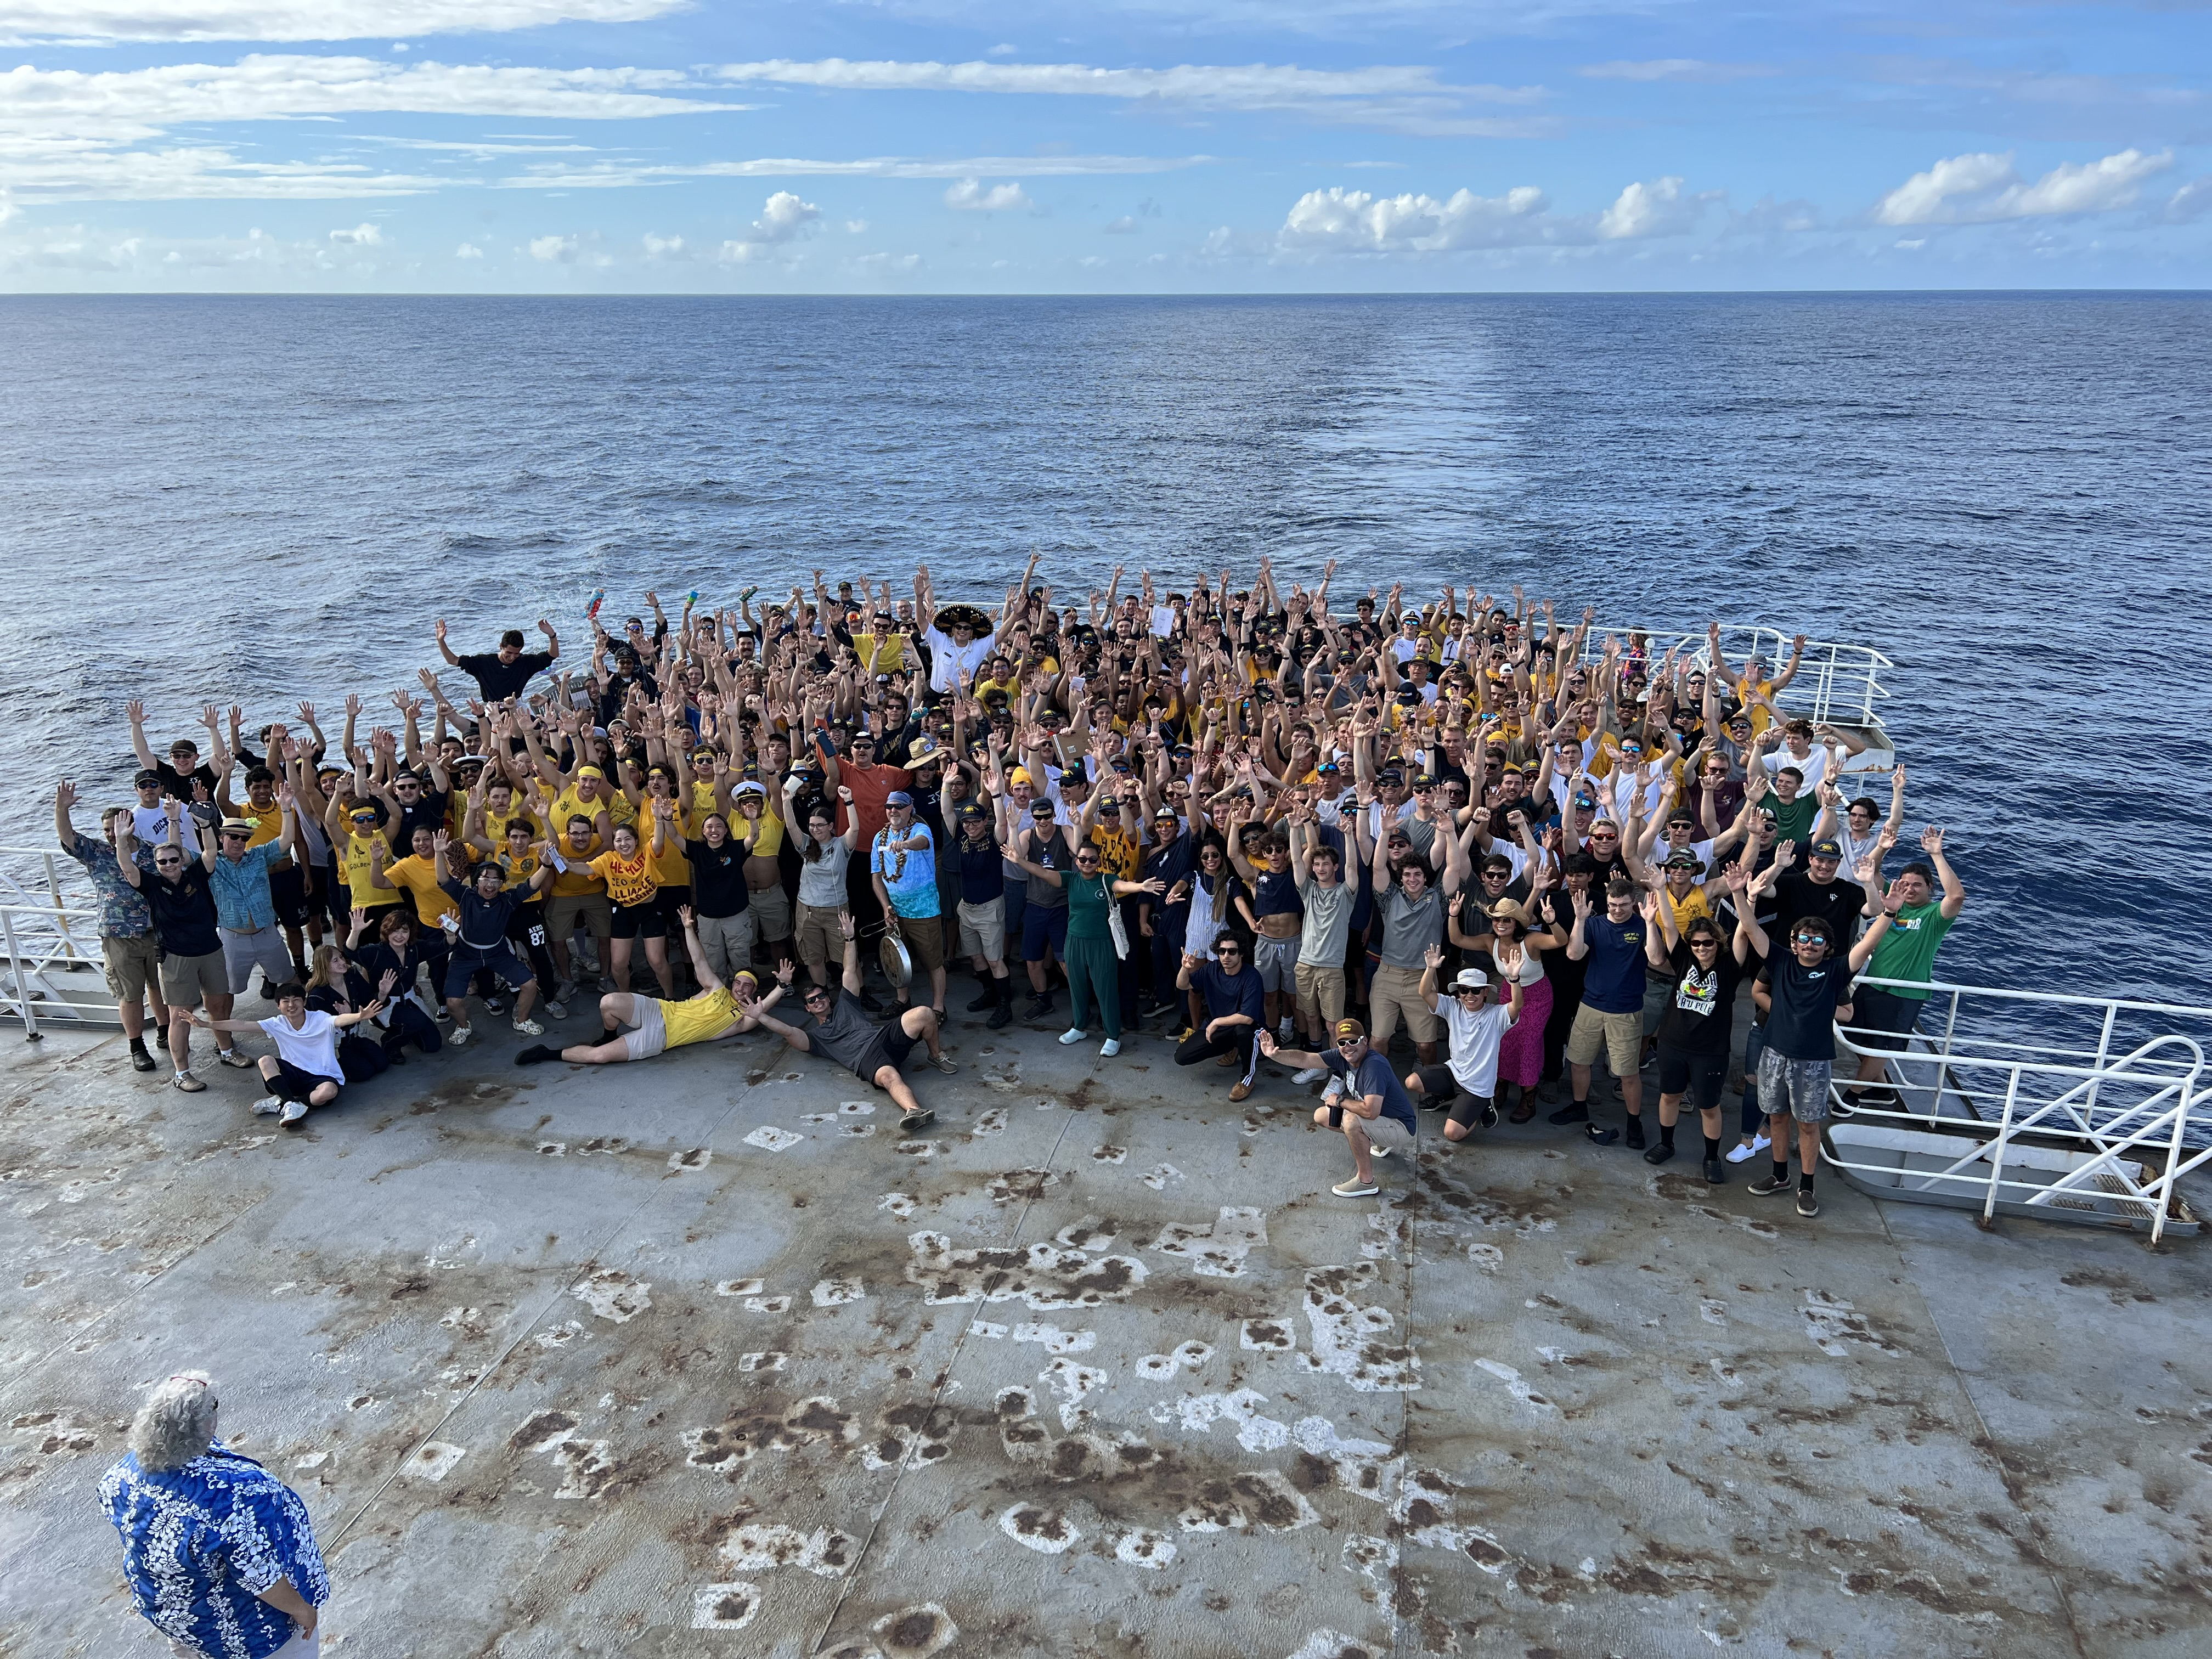
CASE STUDY 2: Eddie and Charlie
Eddie noticed that Charlie was not doing well.
  Charlie was not showering, not eating, and not showing up on time for watch.
  Eddie asked Charlie’s roommate if he was ok, and the roommate said he’s been having night terrors.
  Eddie wasn’t sure how to approach Charlie, so Eddie came to the CAPS counselor on the Bear to share his concern.
  The CAPS counselor coached Eddie on how to talk with Charlie, appropriately inform his superiors, and refer him to CAPS.
  Charlie’s div coms gave him extra encouragement and attention to ensure he felt included and valued.

Slide 42

CASE STUDY 3: Sam’s Dog is Sick
Sam was on the Bear when he learned that his dog was sick and dying.
  Sam’s parents insisted that he complete his cruise.
  Sam found that grieving on the ship alone was causing him to isolate, sleep excessively, not eat, have stomach aches, and lose interest in his classes and project.
  Sam’s roommate noticed he was depressed, and reached out. As it turns out, Sam’s shipmate had also lost a pet recently, and they were able to talk about their grief together. Sam realized he needed to connect with others to feel better and work through his loss.
  Sam started to journal and write long emails home to his family and friends. He also started to eat meals and play music to feel more connected with his shipmates.

Slide 43
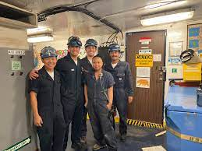
Parting Thoughts
We can be on a ship full of people – but if we are not connecting with them, a ship can be the loneliest place.
Connecting with your shipmates is not always easy. They may seem different, and you may think that you have little in common, but you might be surprised.
Playing music, cards, or video games, singing karaoke, working on sea projects, sharing a meal, telling sea stories, and working out – are all ways you can connect and make lasting relationships with others on the Bear.

Slide 44
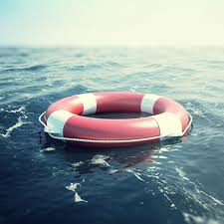
QUESTIONS???

