Slide 1
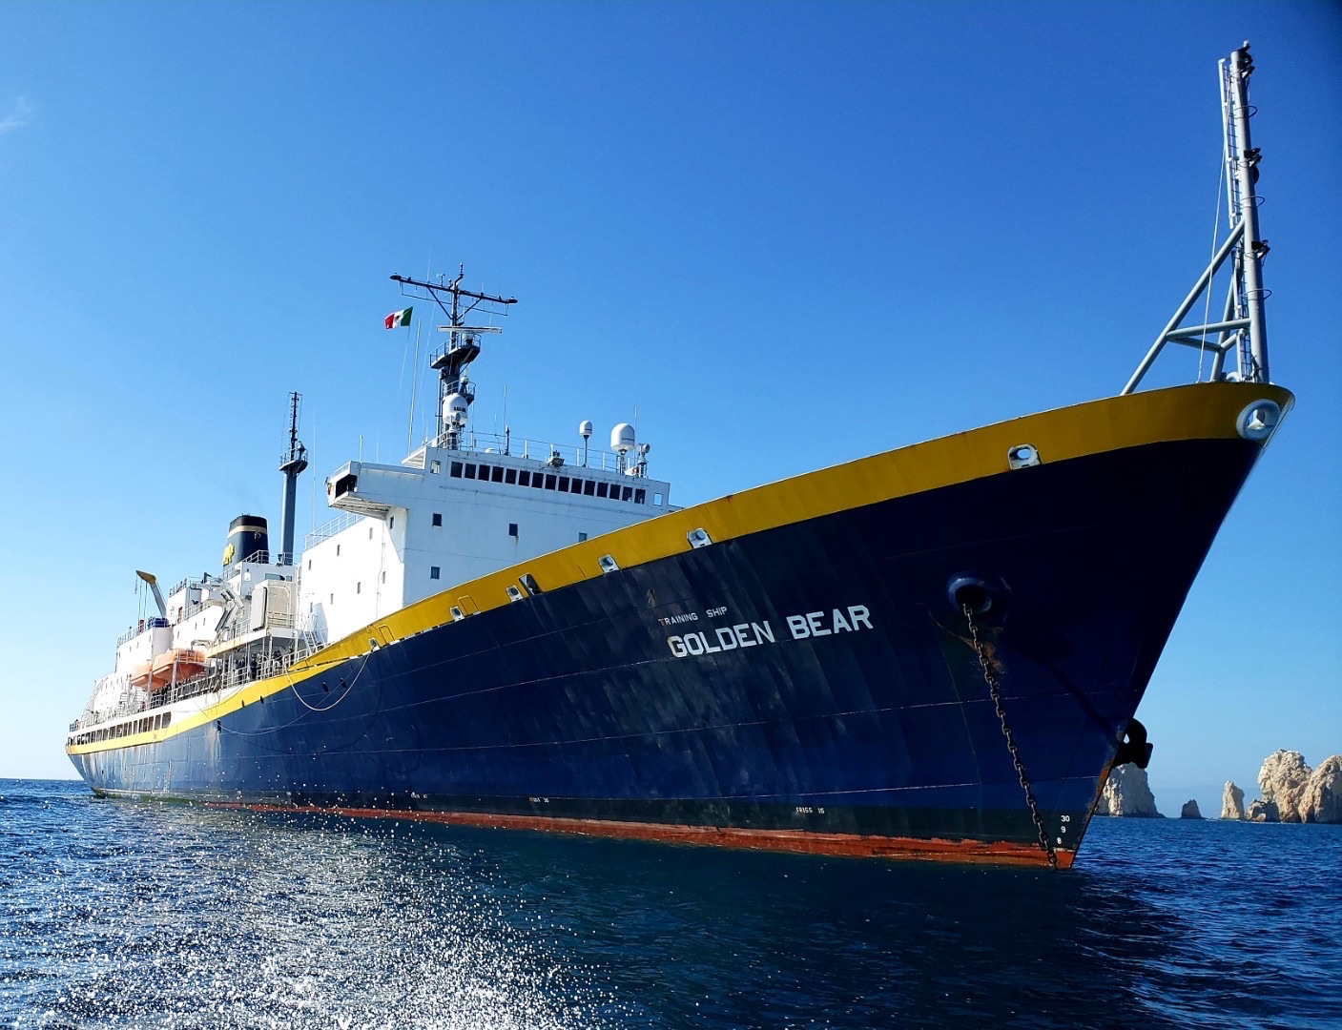
^{Training Ship Golden Bear}
^{Summer Sea Term 2024}
^{Cadet Meeting #6:}
^{April 23rd, 2024}
Security Brief & Handbook Signing
^{Captain Bannister}
^{Commandant Moore}
^{NCIS Special Agent Inka Noonan}
FBI Staff Operations Specialist Kasey Malcoun
^{FBI Special Agent Ryan Kinder}

Slide 2

TSGB Summer Sea Term Counterintelligence Briefing - 2024
NCIS Special Agent Inka Noonan
FBI Staff Operations Specialist Kasey Malcoun
FBI Special Agent Ryan Kinder

Slide 3
Agenda
Situational Awareness & Intelligence
Intelligence Recruitment Cycle
Professional Behavior
Register with U.S. Department of State Safe Traveler Enrollment Program (STEP)
  https://step.state.gov

Slide 4
Situational Awareness
Trust, Empowerment, and Consequence
Social Media
  Privacy and location settings
  When should I post? What should I post
Topics to Avoid
  Travel arrangements
  Travel schedule
  Group leadership and composition
  Post-graduation job plans

Slide 5
Recruitment Cycle
Spot
Situational Awareness & Intelligence
Intelligence Recruitment Cycle
Professional Behavior
Notes:
Spot: Identifying an individual for potential recruitment- not necessarily with a high level of access but the potential for future access. Can take place anywhere especially non-threatening environments and can be done by a non-official foreign intel officer

Slide 6
Recruitment Cycle
Spot
Access
Notes:
Assess: Who are you? What do you want? What are you motived by? What exploitable weaknesses do you have? Looking for gaps/vulnerabilities in your life. Examples include: drugs/alcohol, gambling, sexual relationships, financial issues, etc.

Slide 7
Recruitment Cycle
Spot
Access
Develop
Notes:
Develop: Cultivate a relationship with you, the nature of the relationship changes, method of communication, setting up times to meet similar to dating

Slide 8
Recruitment Cycle
Spot
Access
Recruit
Develop
Notes:
Recruit: Actual pitch, sometimes overt and other times only from the context. May appeal to ideology, blackmail or financial gain, entering into a clandestine relationship

Slide 9
Recruitment Cycle
Spot
Handle
Access
Recruit
Develop
Notes:
Handle: Tasking and/or providing information (might seem benign at first, a way of testing)

Slide 10
Recruitment Cycle
Turnover/ Terminate
Spot
Handle
Access
Recruit
Develop
Notes:
Terminate: Relationship or access changes, potential openings for re-contact

Slide 11
General Suggestions
Stay with your group
Don't discuss sensitive matters where they can be overheard
  Travel plans, leadership, and membership
  Post-graduation job plans
Be suspicious of quick friendships
  Don’t accept drinks from strangers
  Don’t consume unfamiliar substances
  Avoid sexual overtures

Slide 12
Underlying Assumption
You may be a target of a foreign recruitment effort while on summer cruise.
Report any suspicious behavior
  Avoid investigating the circumstances yourself

Slide 13
Professionalism
“Ambassador” mindset
Avoid political and religious discussions
Avoid black markets
  Counterfeit goods, prostitution, drugs, gambling

Slide 14
TSGB Summer Sea Term 2024 Expected Schedule:
23rd May Steward dept arrives.
24th May 1st Food delivery
26th May 2nd Food delivery
29th May Crew report aboard / Travel
30th May First workday Crew – start food service.
31st May Cadet Leadership reports to the vessel 0900-1500 / prep for cadet move aboard. All TSGB Cadet Leadership meeting at 1600 in Upper Class Mess.
01 June Early move in aboard allowed for all cadets from 0900-1500.
02 June All Cadets move aboard 0900-1500. Liberty Expires for all cadets at 2200.
03 June All hands aboard – Summer Sea Term 2024 Commences
0700 Formation – 1st Uniform Inspection
0830 Helo deck – Captain’s Welcome Speech, Introduce Ships crew.
0930 – 1145 Vessel Familiarization. Station Billets & familiarization / Divisional
1300 – 1500 Rizza Hall TIX / SOCP SASH training
1630-1730 WALK THROUGH F&B & Security Drill
04 June Each division will walk through the Lifeboats, lower and secure for sea. (omit division on watch)
1D 0800-0830 / 1E MES - SWAP 0830-0900
2D 0900-0930 / 2D MES – SWAP 0930-1000
3D 1000-1030 / 3E MES – SWAP 1030-1100
4D 1100-1130 / 4E MES – SWAP 1130-1200
1300 F&B drills & Security Drill (probably will do this 2x times) / Cleaning Party
05 June F&B drills / secure for sea (whatever division was on watch on 4th will conduct LB & MES training)
06 June COI drills for USCG
07 June Secure for sea
08 June Depart Vallejo – Pilot 1200 / shift to anchorage 9 bunker.
09 June Depart SF – outbound for Honolulu Hi
Notes:
Cadets will be assigned to divisions as per the needs of the Academic rotation. We will even out the numbers in the Divsions for Cruise. Everyone please scan this QR code to ensure you accounted for today.
TSGB Ship Staff update: TSGB Cadet Chief Mate Ryan Madden. Deck interviews coming shortly.
TSGB Cadet Chief Engineer interviews occurring now.
Berthing assignments will be made by the TSGB Ship and Cadet staff
Clean Sweep and sanitary inspections will be held daily.1600-1630 Clean Sweep daily. TSGB Cadet Ship staff will be running berthing inspections during this time. Female and Accomodation berthing spaces will be inspected by a specialized team. Captain’s berthing walk throughs are weekly.

Slide 15
Cadet Leadership
Sofia Gomez | 1E CO
Dylan Joelson | 1E XO
Connor Wadhams | 2E CO
George Hutson | 2E XO
Nat Pierotti | 3E CO
Jack Durheim | 3E XO
Tony Perez | 4E CO
Nolan Bronstrup | 4E XO
Raven Frisell | 1D CO
Malcolm Veach | 1D XO
Maria Djaya | 2D CO
Ben Voth | 2D XO
Safari Frisell | 3D CO
Ashlinn Mcgovern | 3D XO
Alayna Celestine | 4D CO
Brandon Lara | 4D XO
Sarai Alonso | Corps Training Ship Commander
Ryan Downey | Cadet Chief Mate
Francis Sherman | Cadet Second Mate
Benjamin Hughes | Cadet Third Mate
Erin Hulti | Cadet Third Mate
Maya Sortor | Cadet Chief Engineer
Parker Forsythe | Cadet First Engineer
Aris Spanos | Cadet Second Engineer
Etienne Quille | Cadet Third Engineer
Notes:
Cadets will be assigned to divisions as per the needs of the Academic rotation. We will even out the numbers in the Divsions for Cruise. Everyone please scan this QR code to ensure you accounted for today.
TSGB Ship Staff update: TSGB Cadet Chief Mate Ryan Madden. Deck interviews coming shortly.
TSGB Cadet Chief Engineer interviews occurring now.
Berthing assignments will be made by the TSGB Ship and Cadet staff
Clean Sweep and sanitary inspections will be held daily.1600-1630 Clean Sweep daily. TSGB Cadet Ship staff will be running berthing inspections during this time. Female and Accomodation berthing spaces will be inspected by a specialized team. Captain’s berthing walk throughs are weekly.

Slide 16
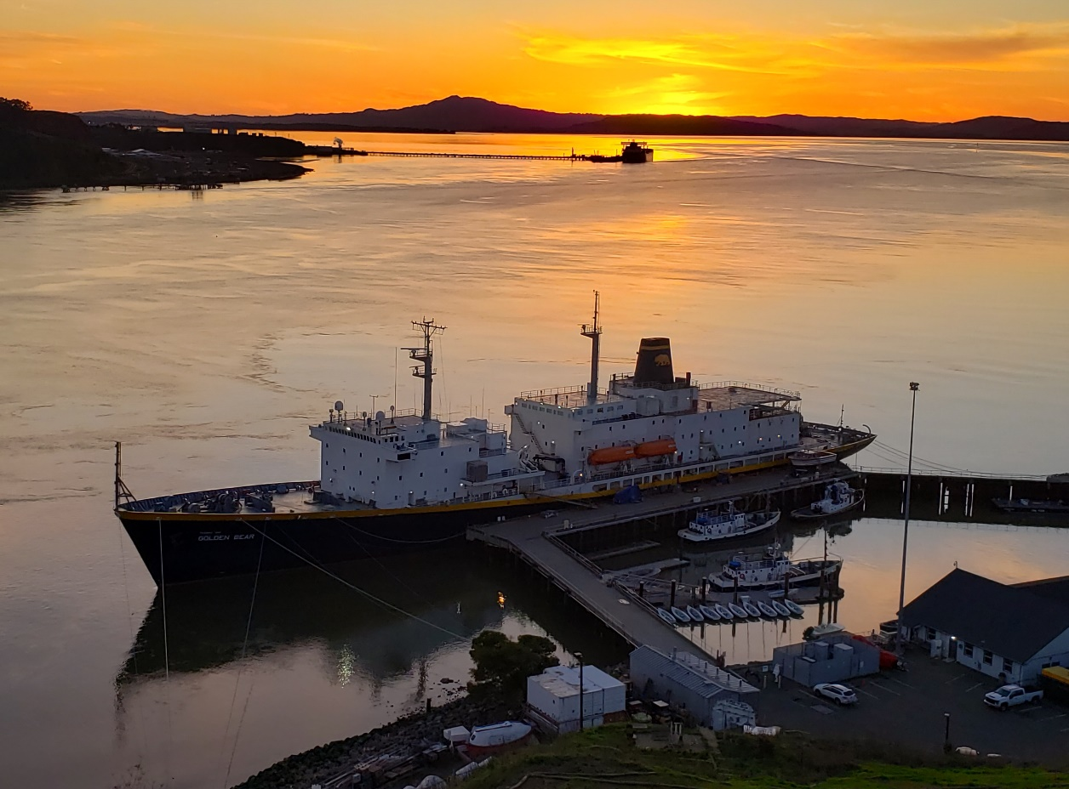
Handbook Signing
Discuss any pending issues in the handbook, and then sign in with your Divisional Staff
A physical signature is required that you have read and understood the policies in the 2024 SST Handbook to sail onboard the TSGB for 2024 Summer Sea Term.
Reminder that when reporting aboard please only bring large duffel bag style luggage. No hard luggage or containers. NO large Televisions!
All accommodations need to go through official channels: ADSO & Student Health Center. Accommodations from Spring 2024 semester do not apply and would need to be renewed for Summer Sea Term 2024 pending approval.
This is our last meeting before Summer Sea Term so ask the questions if you have them to your Divisional Staff!
Notes:
Cadets will be assigned to divisions as per the needs of the Academic rotation. We will even out the numbers in the Divsions for Cruise. Everyone please scan this QR code to ensure you accounted for today.
TSGB Ship Staff update: TSGB Cadet Chief Mate Ryan Madden. Deck interviews coming shortly.
TSGB Cadet Chief Engineer interviews occurring now.
Berthing assignments will be made by the TSGB Ship and Cadet staff
Clean Sweep and sanitary inspections will be held daily.1600-1630 Clean Sweep daily. TSGB Cadet Ship staff will be running berthing inspections during this time. Female and Accomodation berthing spaces will be inspected by a specialized team. Captain’s berthing walk throughs are weekly.

