Slide 1
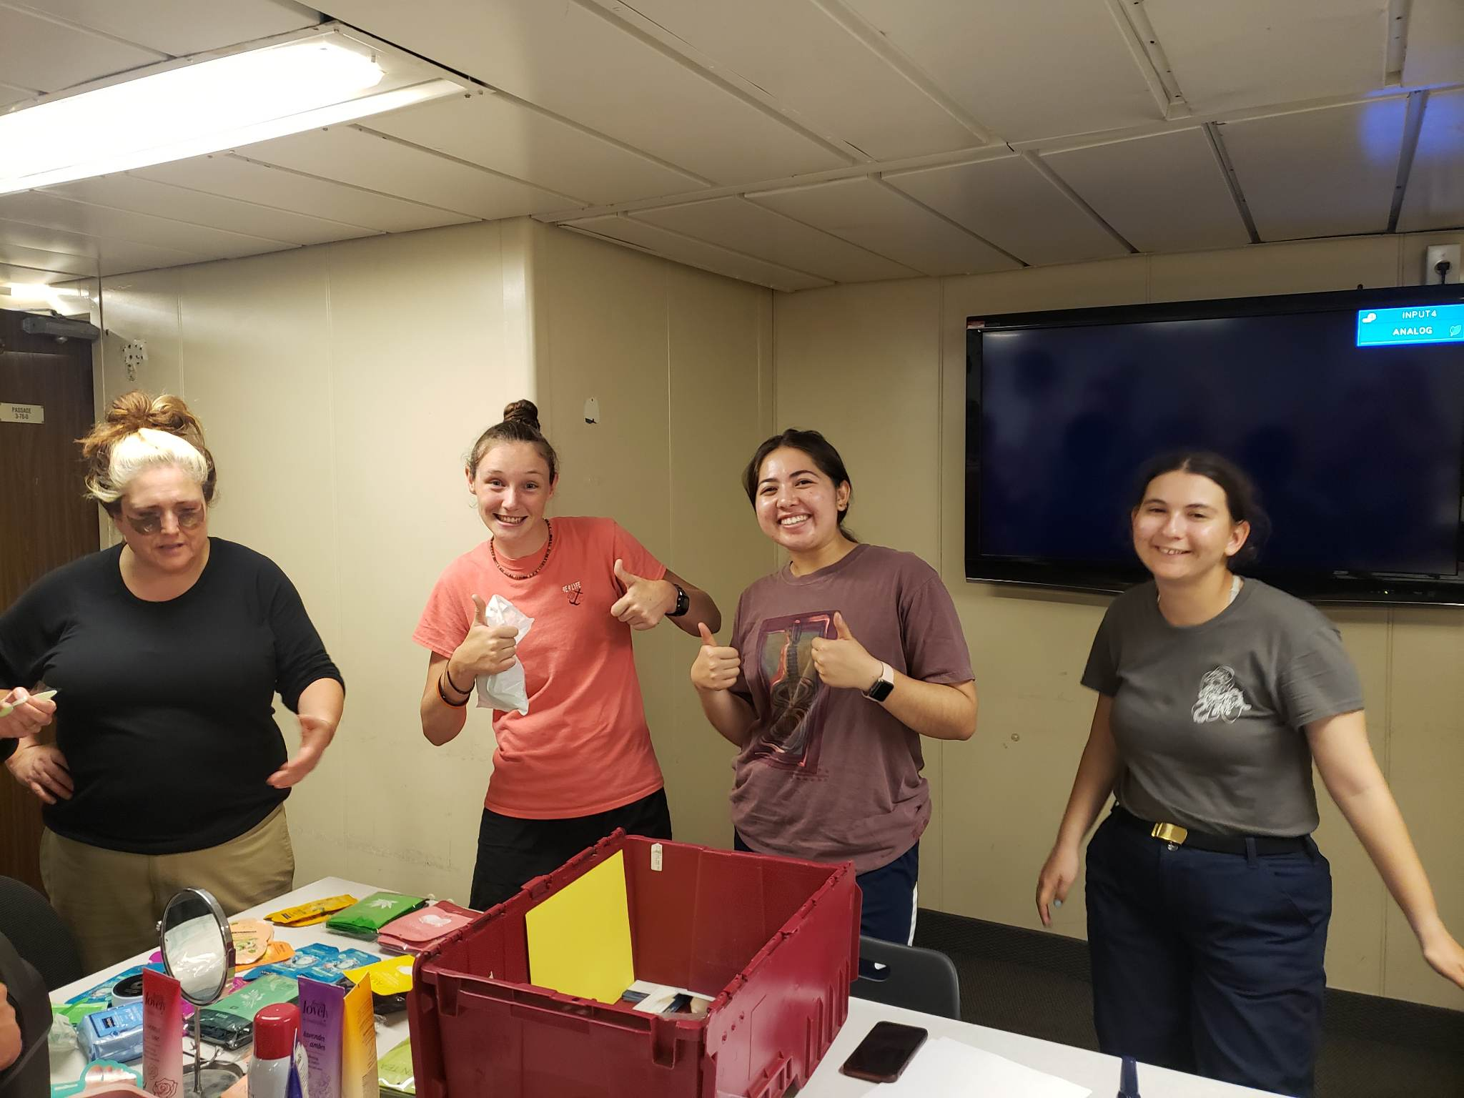
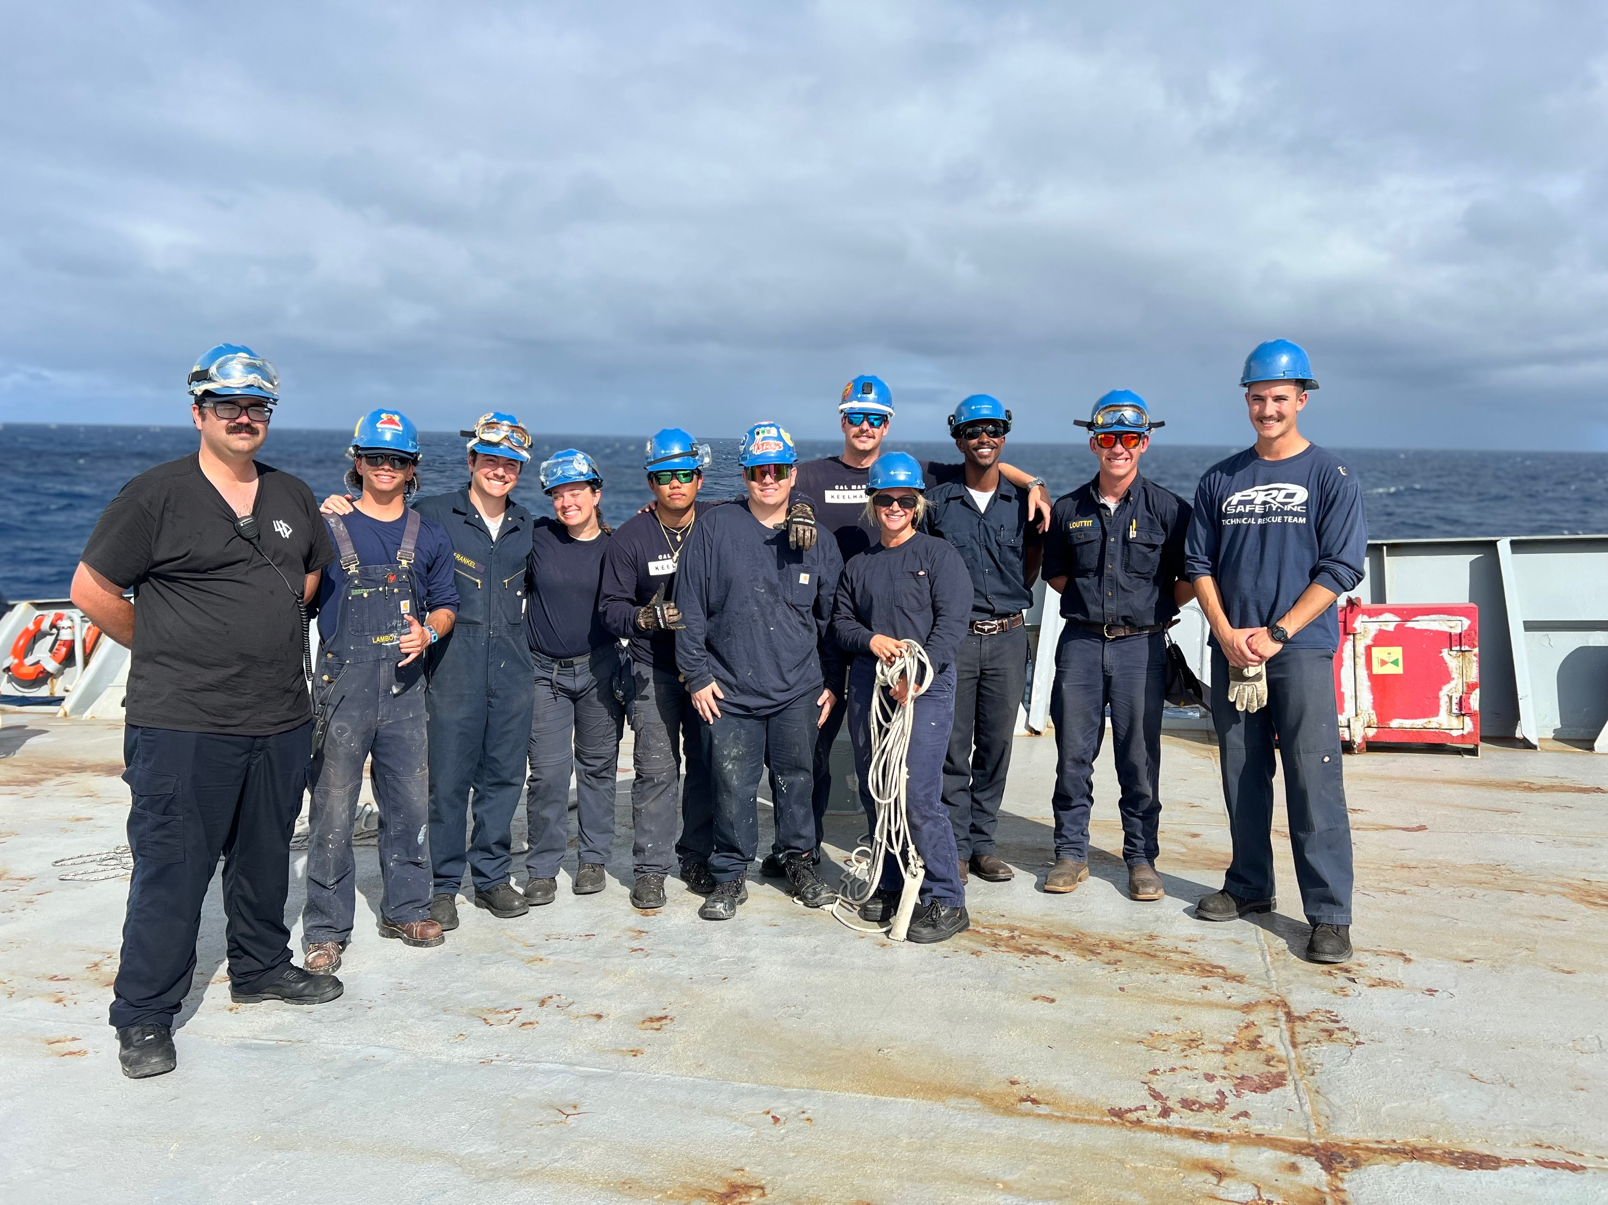
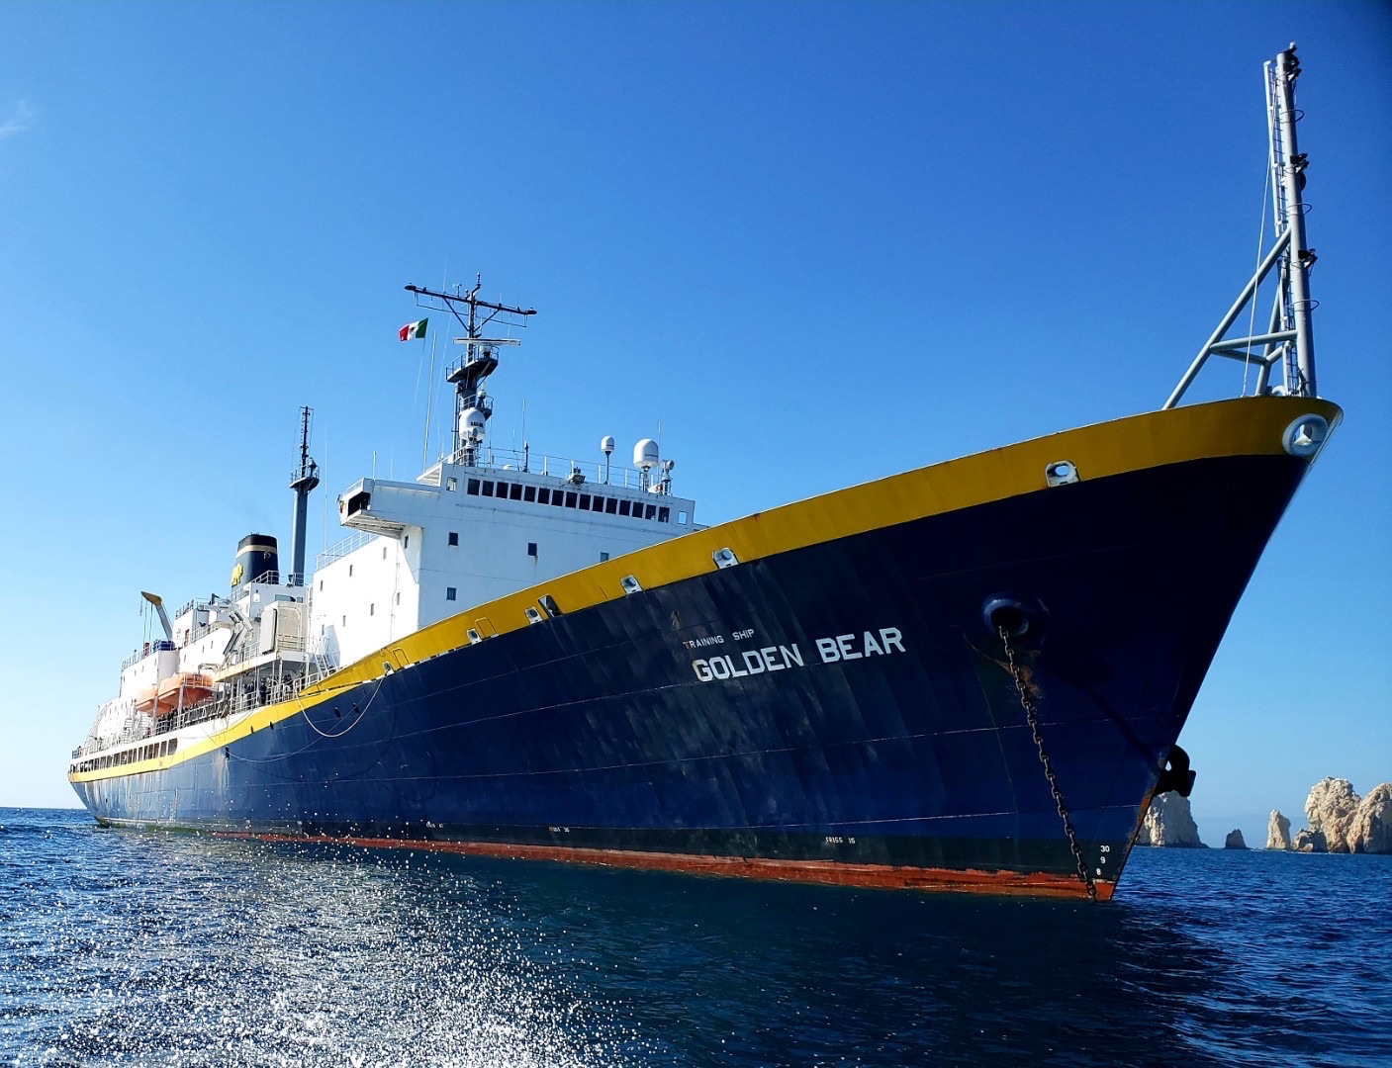
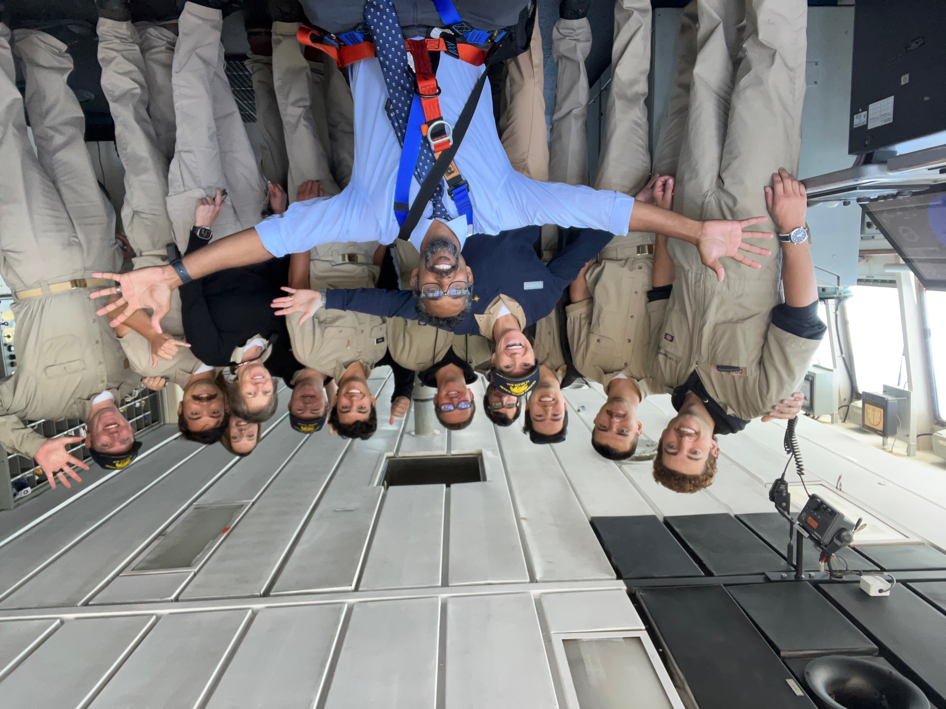
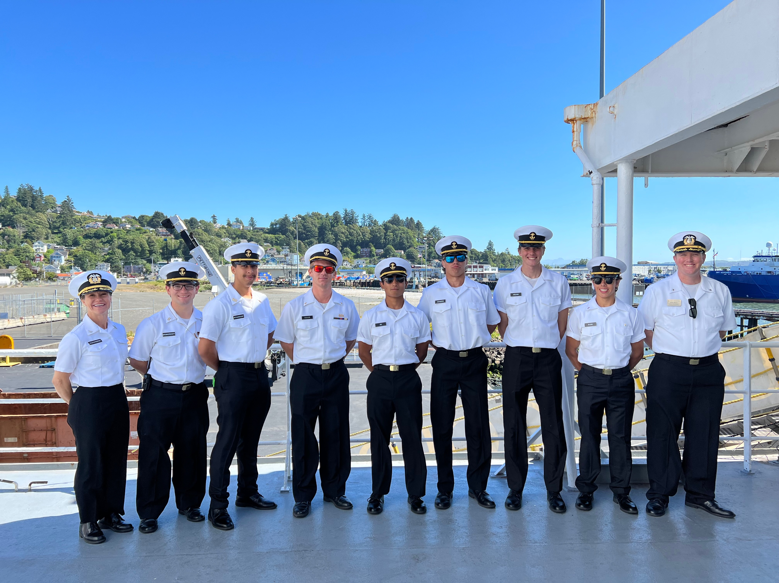
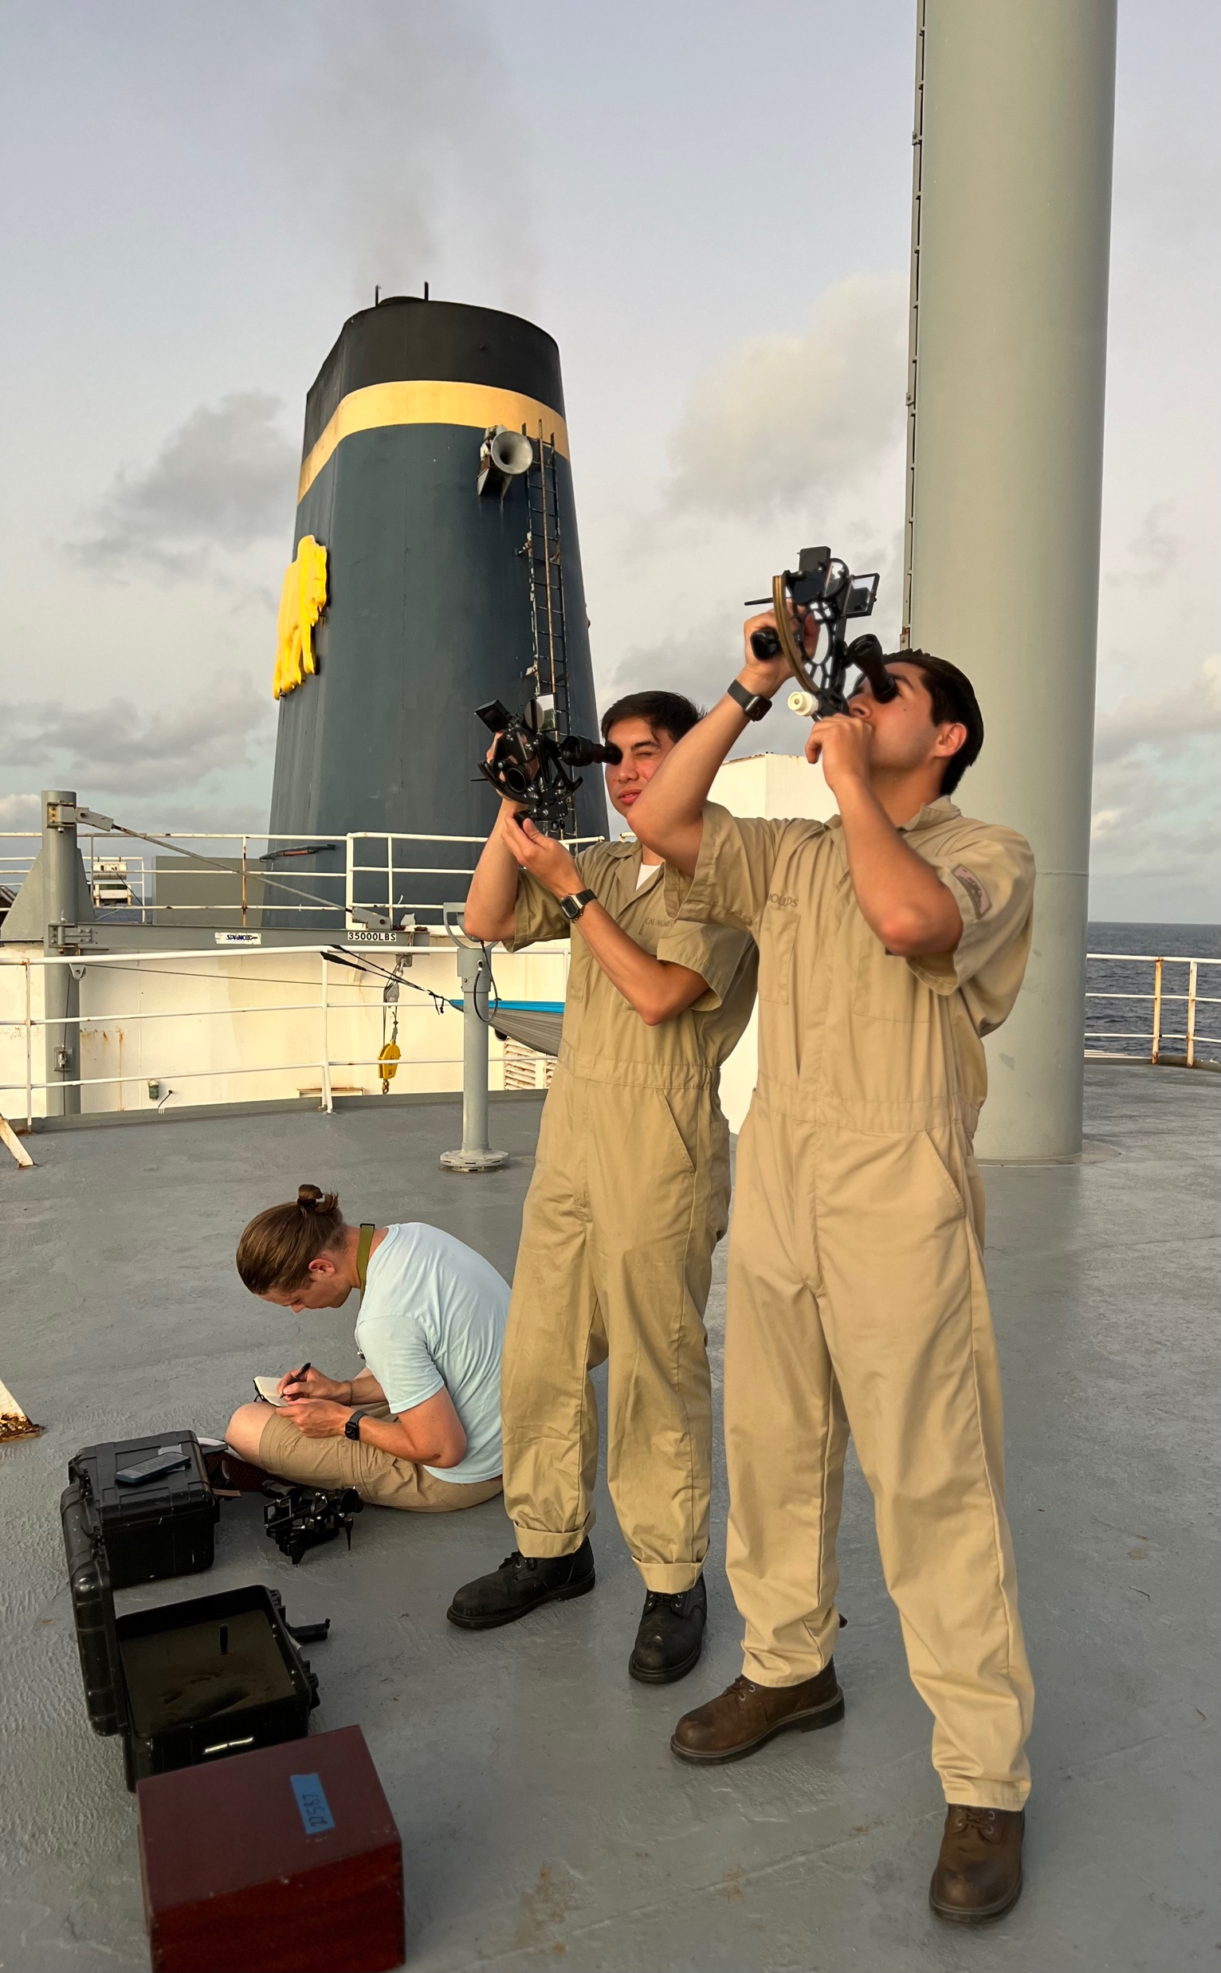
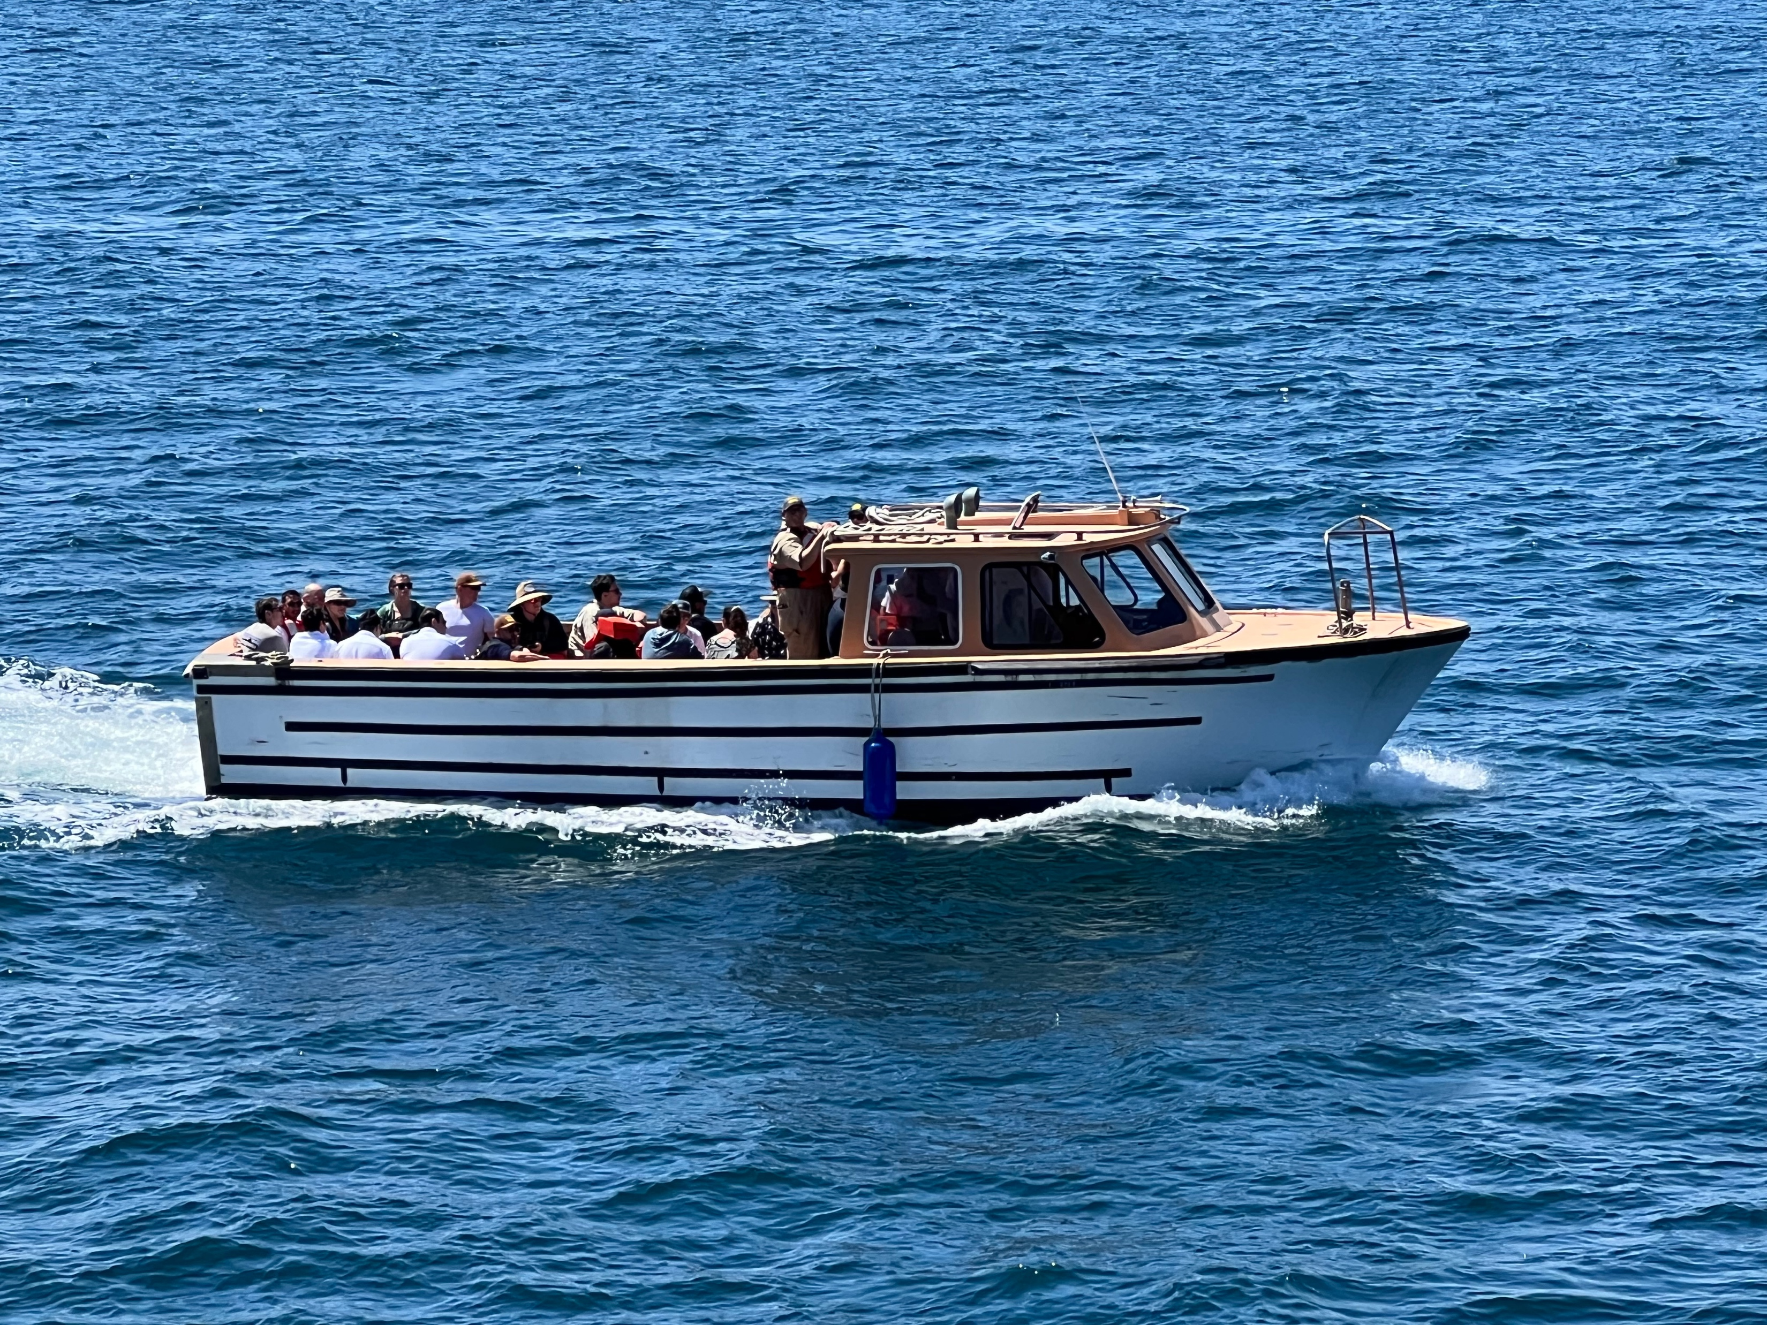
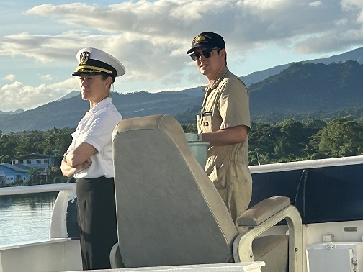
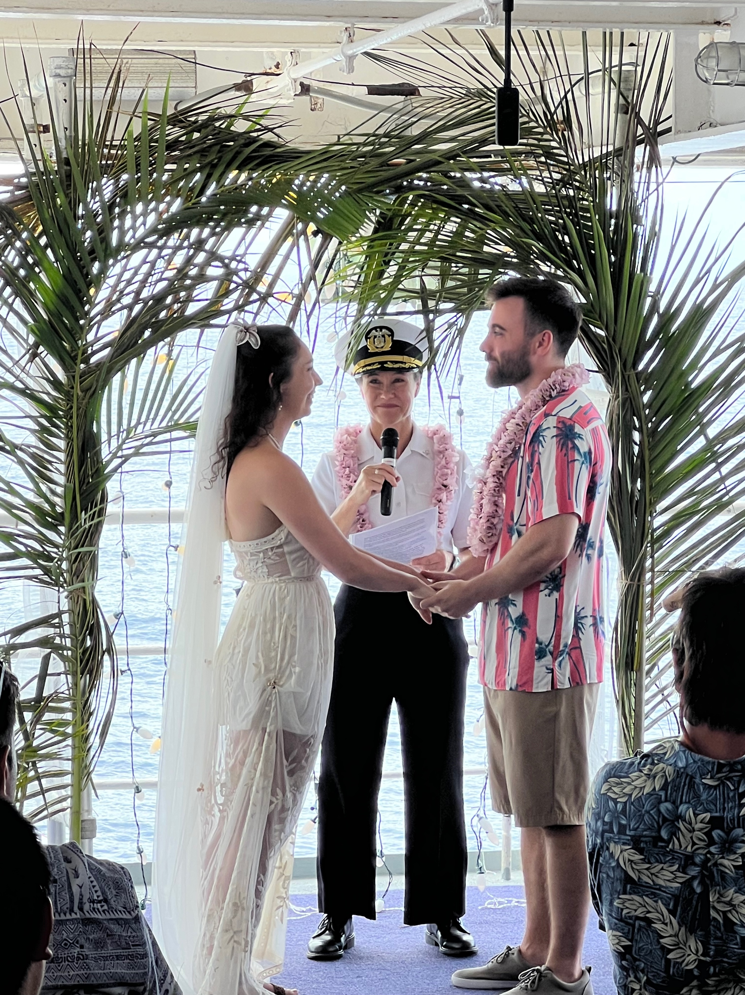
^{Training Ship Golden Bear}
^{Summer Sea Term 2024}
Cruise Conduct, Divisional Assignments, Berthing Requests – Commandant Moore & Captain Bannister
DEI – Meagan Nance, Director of Inclusion Initiatives & Chaplain Jenny Klouse
Morale, Welfare, Recreation – Matt & Malinda

Slide 2
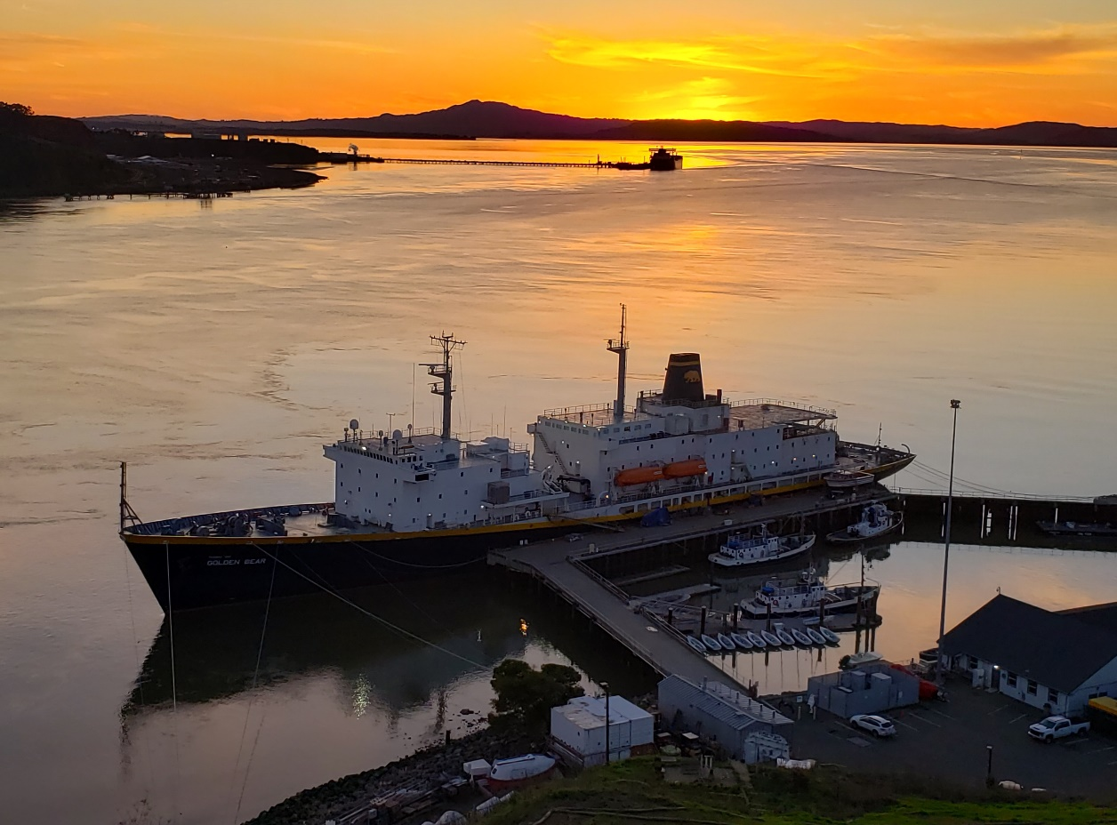
TSGB Cruise 2024 Training Session 3/28/24
Cruise Schedule/Important Dates
Uniform & Grooming Standards
Professional Conduct
TSGB Policies
Shipboard Safety & Drills
Cruise Services
Diversity, Equity & Inclusion Onboard
Divisions, Academic rotations, berthing assignments
Cruise Handbook/Packing List to Come
Required Documents Due: May 3rd, 2024

Slide 3

Cruise 2024 Schedule/Important Dates
March 28th: Cadet Cruise Meeting #4: Conduct, DEI, MWR(Morale, Welfare & Recreation), Berthing, Divisional Assignments. 1100-1200. Location: Rizza
April 11th: Cadet Cruise Meeting #5: Cruise Protocols, Cruise Handbook Review. 1100-1200. Location: Rizza
April 25th: Cruise Handbook Signing. Final check with Captain and Commandant. 1100-1200. Location: Rizza
Apr 29- May 2: Final Exam Period
May 2-May 5: TSGB Cruise Cadet Early Move aboard. See specifics below.
May 2: TSGB Cruise Cadet Ship Staff Move-Aboard
May 3: Commencement Rehearsal for Seniors UOD Salt & Peppers. TSGB Graduating Seniors Allowed to move aboard; specific times tbd. Bookstore will be open at 0800. Commencement Volunteers Needed. Special Vallejo liberty for volunteers. Please email Craig Hennike at chennike@csum.edu.
May 4: Commencement. UOD Salt & Peppers for graduating Seniors. TSGB Cruise All remaining Seniors allowed to move aboard; specific times tbd. Bookstore will be open at 0800.
May 5: TSGB Cruise Freshmen allowed to move aboard; specific times tbd.
May 6: TSGB Cruise begins for all hands at 0001am. All cadets going on Cruise required to be aboard.
May 6-9: Cruise Indoctrination period. In port Vallejo.

Slide 4
Captain Bannister & Commandant Moore:
Cruise Conduct
Introduction

Slide 5
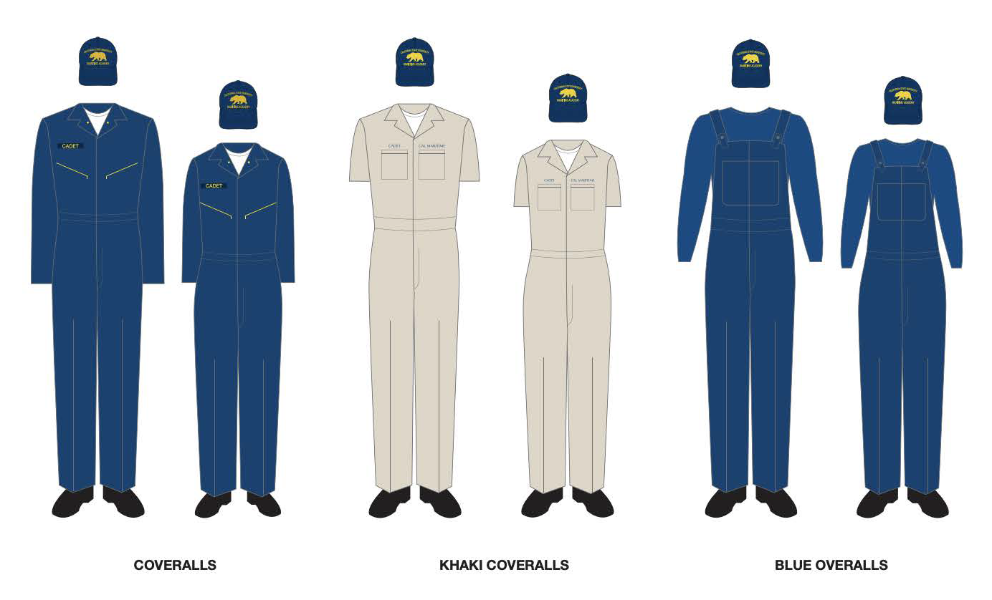

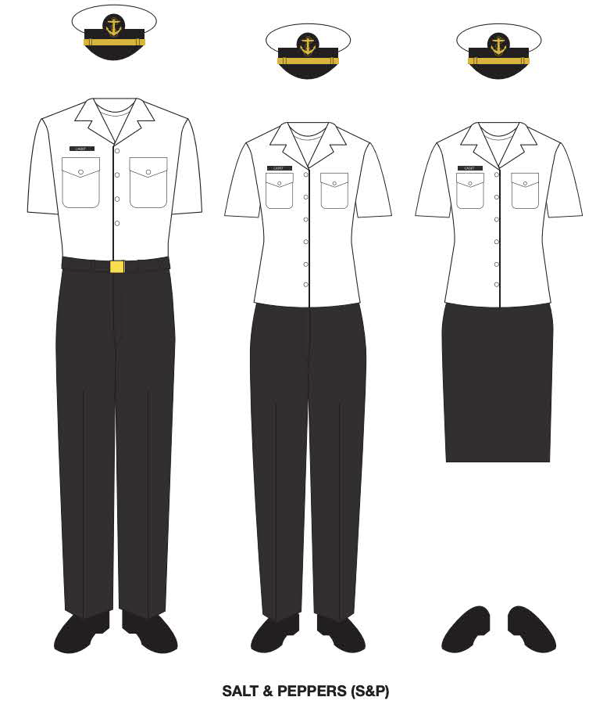
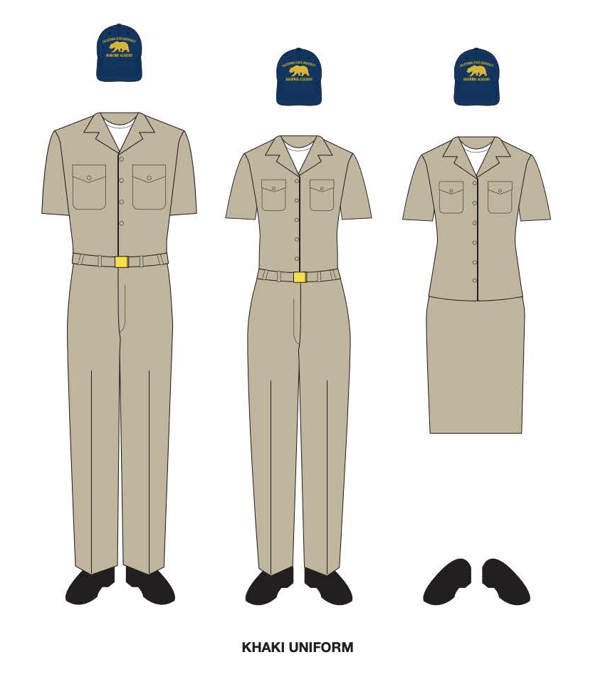

Uniform & Grooming Standards
Required Uniforms
Khaki Coveralls/Khaki Uniform
Coveralls or Overalls with Navy
Blue Long Sleeve Shirt
Salt & Pepper Uniform
Grooming Standards
All grooming standards apply as per the 2023-2024 Cadet Handbook. Any Exceptions to Policy must be approved through the Office of the Commandant. Uniform & Grooming Standards are required as PPE for Shipboard Activity
Don’t forget to pick up your Khaki Coveralls from the bookstore, and perhaps a second Cal Maritime Ball Cap.
Click Here to Access the Cadet Handbook Onine

Slide 6
Professional Conduct
Proper Decorum
It is the intent of the Master that all ship's officers and cadets conduct themselves in a way appropriate to the standards of our profession. The use of vulgar or profane language either while conducting business or while being able to be overheard by others is acceptable neither on board the training ship nor ashore in port. All personnel are advised to be attentive to their behavior in this regard. The appearance of the vessel and the conduct of her crew shall reflect the high standards expected at Cal Maritime. Additionally, the training ship is an important state and federal asset. As such, the image she and her crew present, whether at home or abroad, should reflect favorably on the United States of America, the State of California and the California State University system

Slide 7
Professional Conduct
Requirements for Cruise
TSGB is a merchant vessel, sailing under the authority of International and Federal Maritime law. Therefore, all shipboard personnel, including cadets, are required to treat all regulatory authorities with respect and to obey lawfully given orders.
Notes:
Unlike passengers on cruise ships, you will be expected to participate in some aspect of operating the vessel. You have a job to do aboard the TSGB: that is to learn your chosen profession. The academic unit oversees the classroom activities and the curriculum component of each sea-training course. The learning experience includes going to class, attending emergency drills, standing watch on the bridge or in the engine room, daily cleaning and many other activities. Due to the inherent dangers of being at sea, you will be expected to follow a more structured daily routine than when ashore. Be sure that you keep yourself informed as to how that structure applies to you. Knowing things like what time to be back to the ship, what your station for emergency drills is, or what you wear to dinner will make your life much easier. Normally, specific orders will only be given in safety and operationally sensitive situations, but at that time you must understand that it is your responsibility to comply with directives given by the person in authority.

Slide 8
Professional Conduct
Using the Chain of Command
The Chain of Command exists so that shipboard operations run smoothly and safely. Whenever you have a question or issue that may need resolution, it is imperative that you raise these issues with your direct supervisor first. For cadets, this means approaching your Cruise Division Executive Officer or Division Commander. If they are unable to resolve your situation, then you should raise the issue with either the Company Chief Engineer or Company Chief Mate, whomever is your respective department head.
Ask your Division Commander!

Slide 9

TSGB Policies
Smoking/Chewing Tobacco/E-Cigarettes/Vapes not allowed on TSGB
Alcohol Policy DO NOT BOARD THE SHIP UNDER THE INFLUENCE. Zero tolerance.
SHORESIDE SECURITY CHECKPOINT WILL ENFORCE AND REPORT CADETS VIOLATING ALCOHOL POLICY
Drug Testing Policy as per 2023-2024 Cadet Handbook. Zero tolerance.
Cadet Mast/Captain's Mast
Non-Discrimination Policy
Customs & Contraband
.04% or below BAC required
Notes:
A BAC .04% or less is required to board the TSGB. For those of you who don't know that is about one beer. In port the watch will maintain a hydration and seating area on the pier next to the vessel. If the watch or one of your peers notices that you are tuned up DO NOT BOARD THE VESSEL. If you make it to the Hydration station before liberty expires you will be accounted for, and we will provide support if needed. Once again DO NOT BOARD THE SHIP if you feel over the limit.This is the fastest way to fail Cruise. We want you to have fun but safety is the number one priority for all aboard the ship.
Customs comes onto the ship in every International port we travel to.

Slide 10

Shipboard Safety & Drills
During the course of cruise, when underway, there will be a number of Fire & Boat Drills and Man Overboard Drills. Drills are not usually conducted while in port or on weekends, but unannounced drills may be held at ANY TIME. All hands must participate in all emergency drills.
PAY CLOSE ATTENTION TO YOUR DUTIES
AS ASSIGNED BY THE STATION BILL!
.

Slide 11

Cruise Services
.
Computer Lab
Galley
Gymnasium
Laundry
Leisure Time (Fishing)
Library
Medical Treatment Facility
Pirates Cove
Morale, Welfare & Recreation Events!

Slide 12
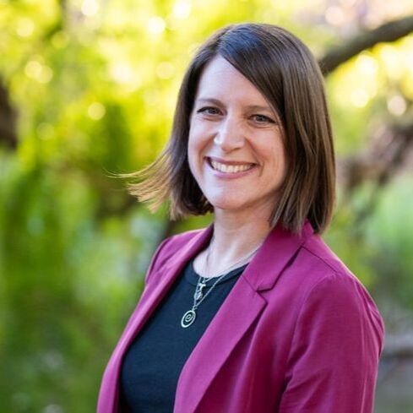
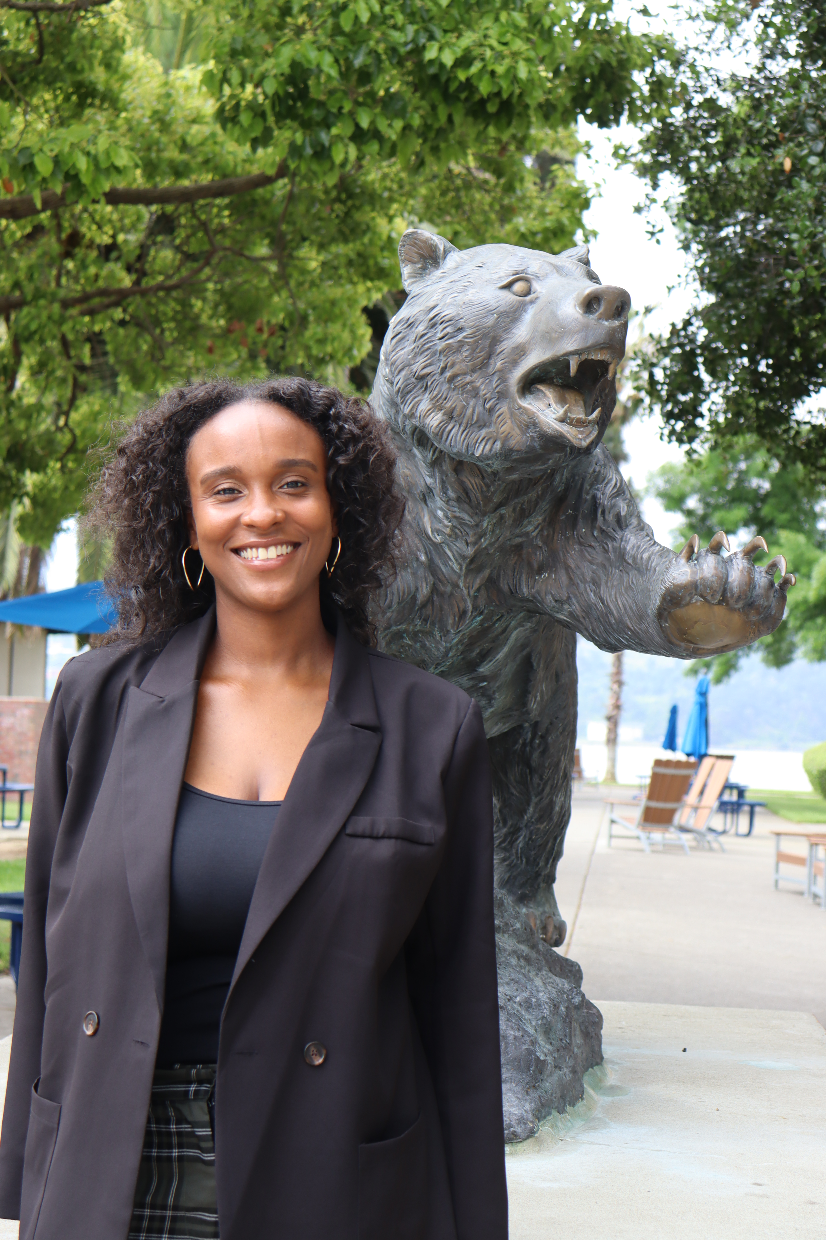
INTRODUCTIONS
Meagan Nance (she/her)
Director of Inclusion Initiatives & EOP (mnance@csum.edu)
Jenny Klouse
Senior Area Ministry Director & Licensed Chaplain (jenny.klouse@intervarsity.org)

Slide 13


WHY WE ARE HERE...
Inform all cadets, students, and ship crew about available resources related to diversity and inclusion services such as support networks and resources. We want to encourage everyone to utilize these resources for personal growth, support, and promoting a more inclusive environment on board.
Introduce guidelines and initiatives to ensure that all spaces on the training cruise are inclusive and welcoming to individuals of diverse backgrounds.

Slide 14
Diversity & Inclusion -Friendly Events & Resources
Resources available
  Travel guides and books in the TSGB Library
  Crafts and games in the Library and Pirate's Cove
Cultural events related to your destinations
  Customs, language, food, games, movies
Inclusive spaces
  "Women's Wellness Hour" Gym - 0600am-0700am (All Gender Identities Welcome)
  Spiritual hour at the Library
  Library as a place to read, connect, craft & relax

Slide 15
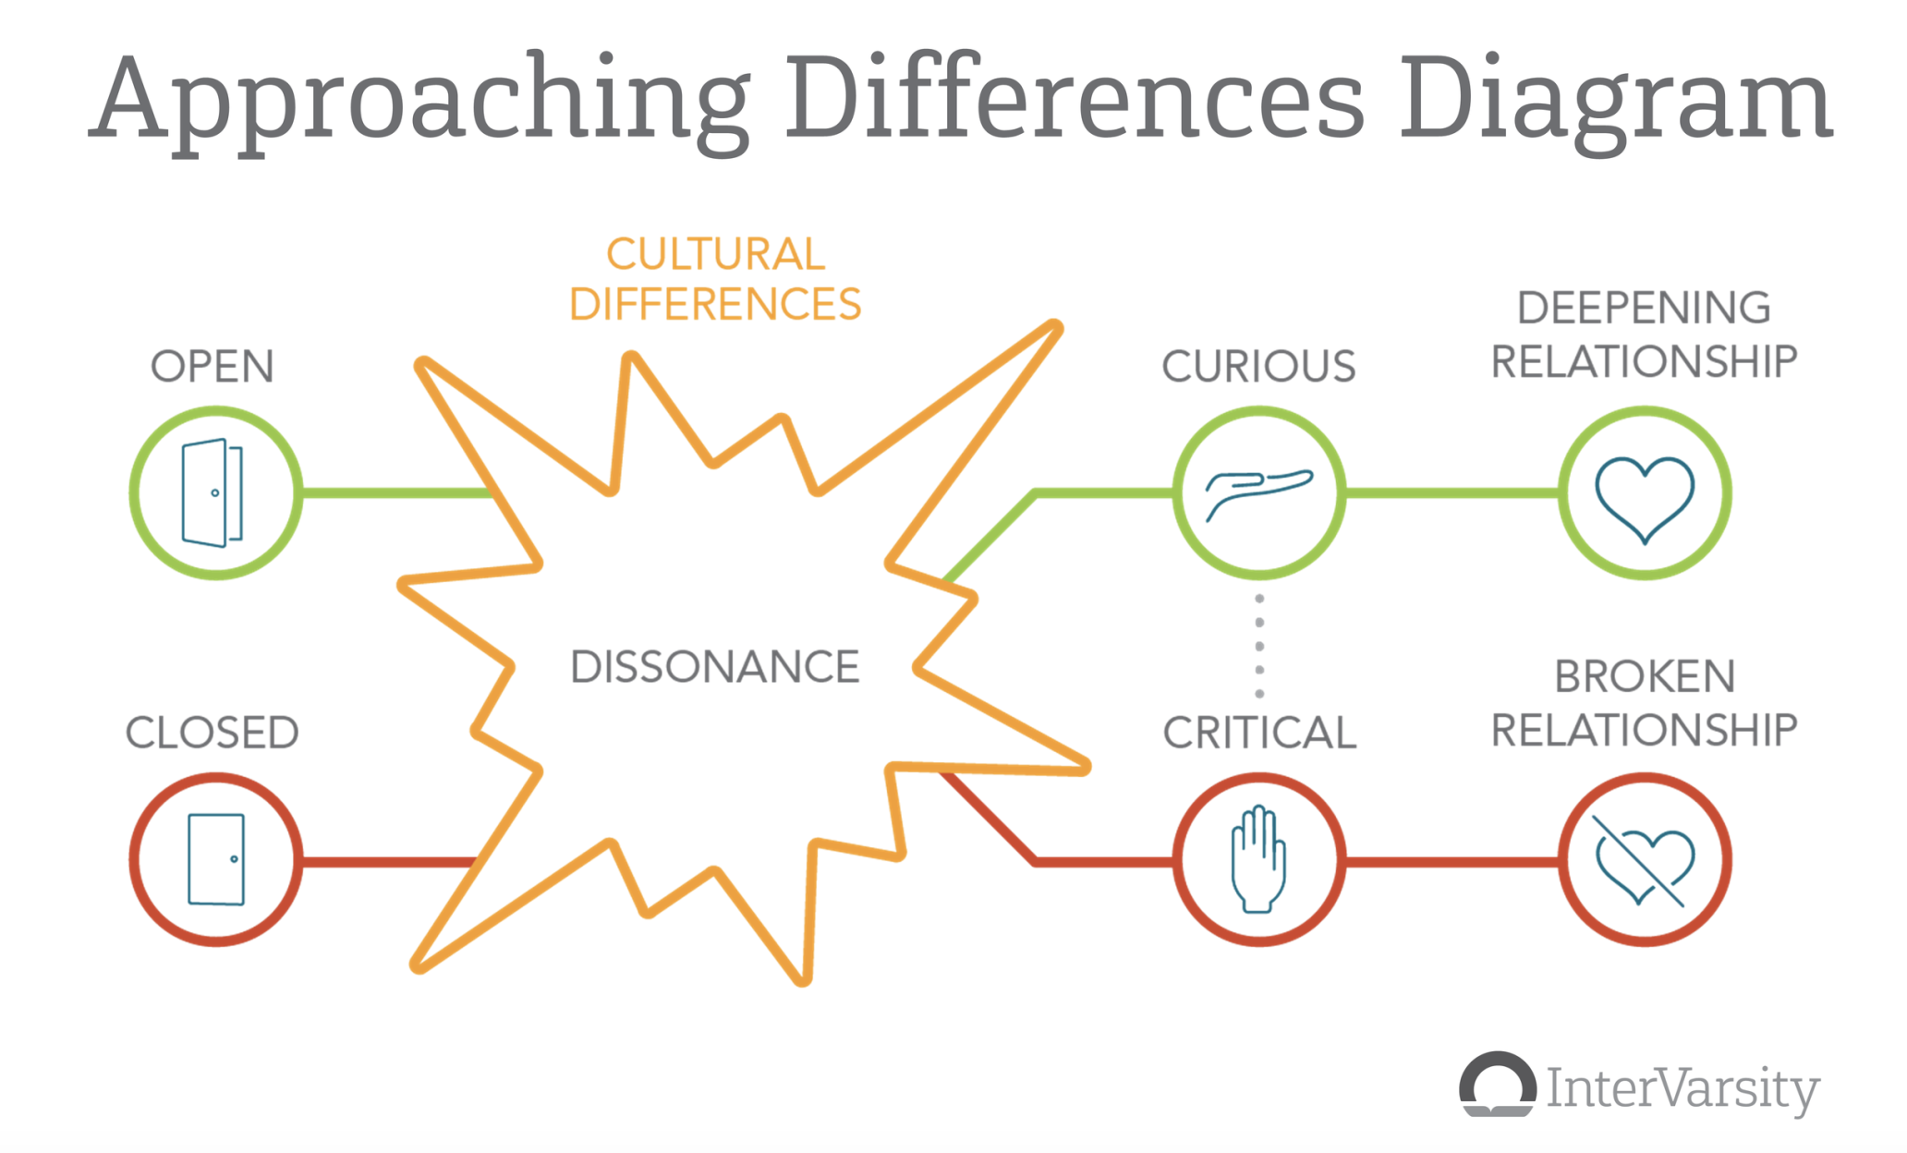
Preparing for Cross-Cultural Experiences

Slide 16
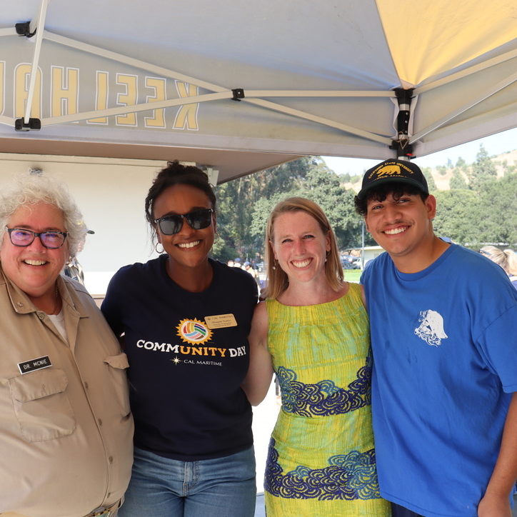
Questions? Comments? Concerns?
The DEI Council welcomes and values feedback from all members of the campus community. Please direct any comments or concerns directly to the council via email (DEICouncil@csum.edu)

Slide 17
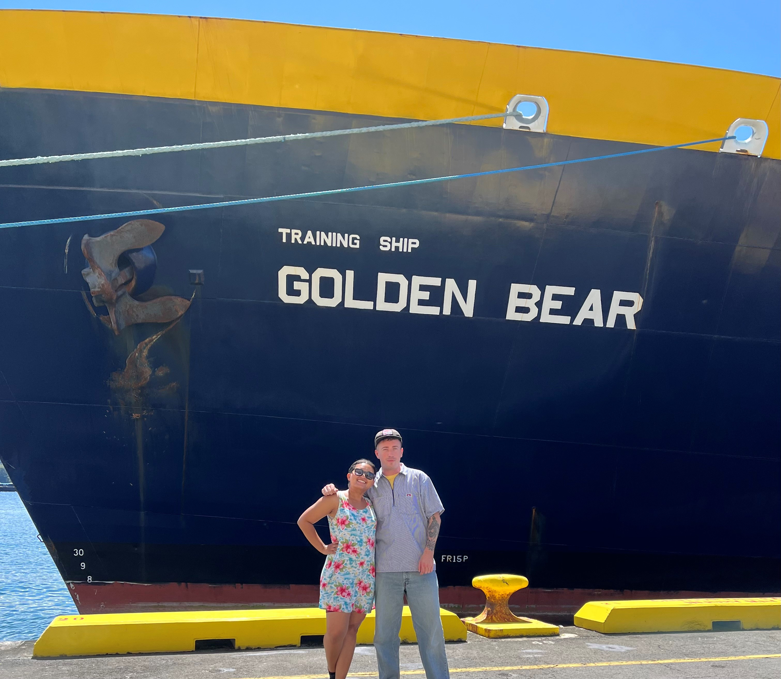
Your Morale, Welfare, & Recreation (MWR) Officers
Malinda Balfour & Matt Donovan

Slide 18







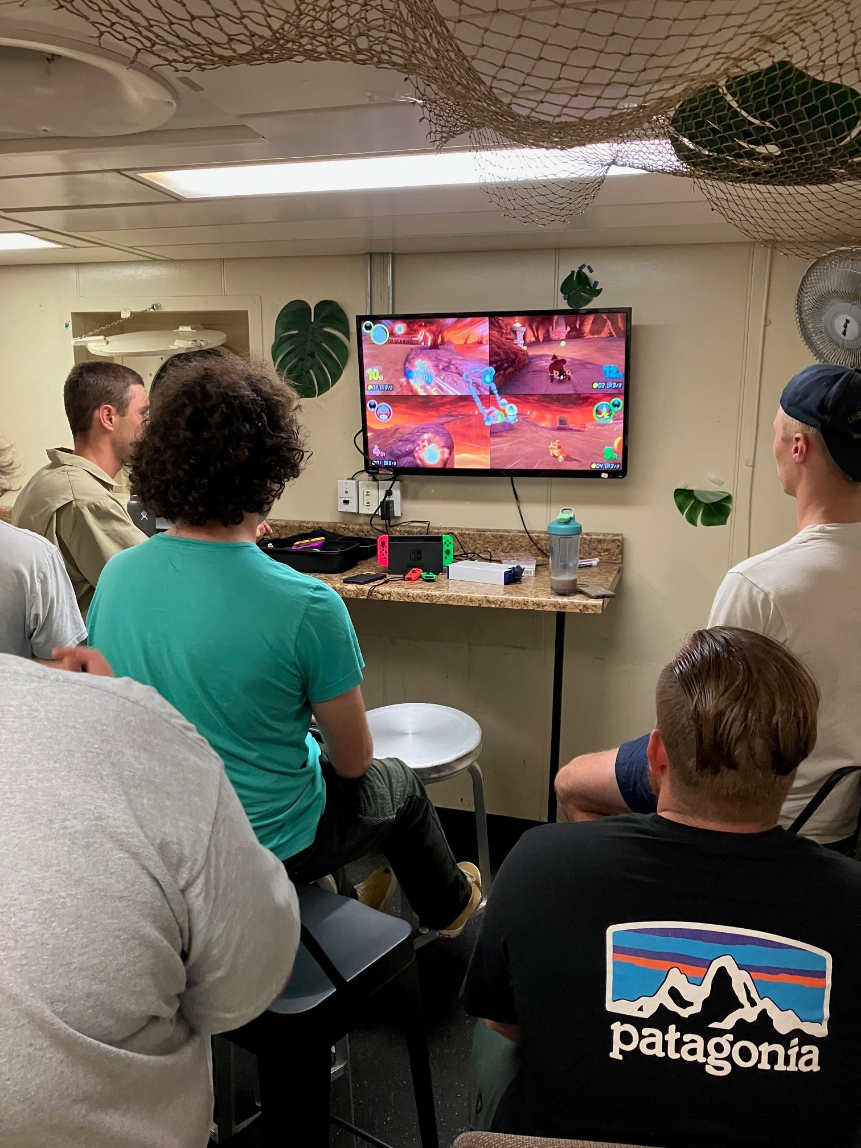
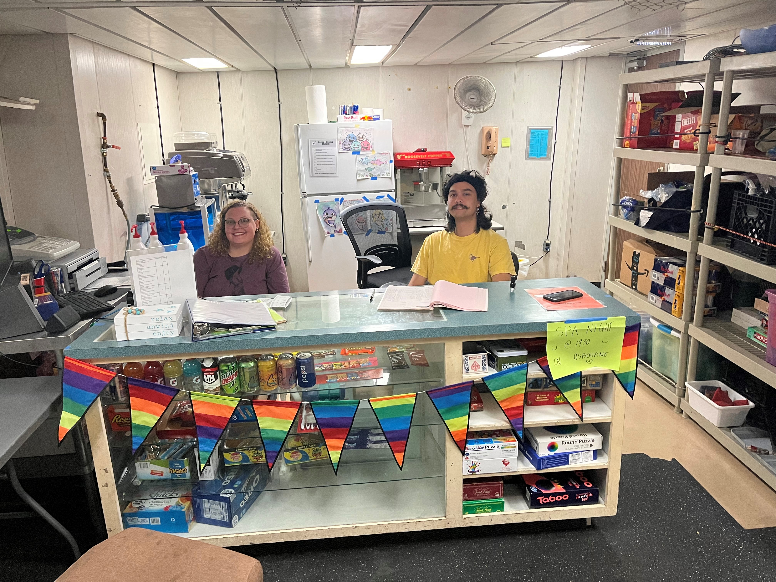


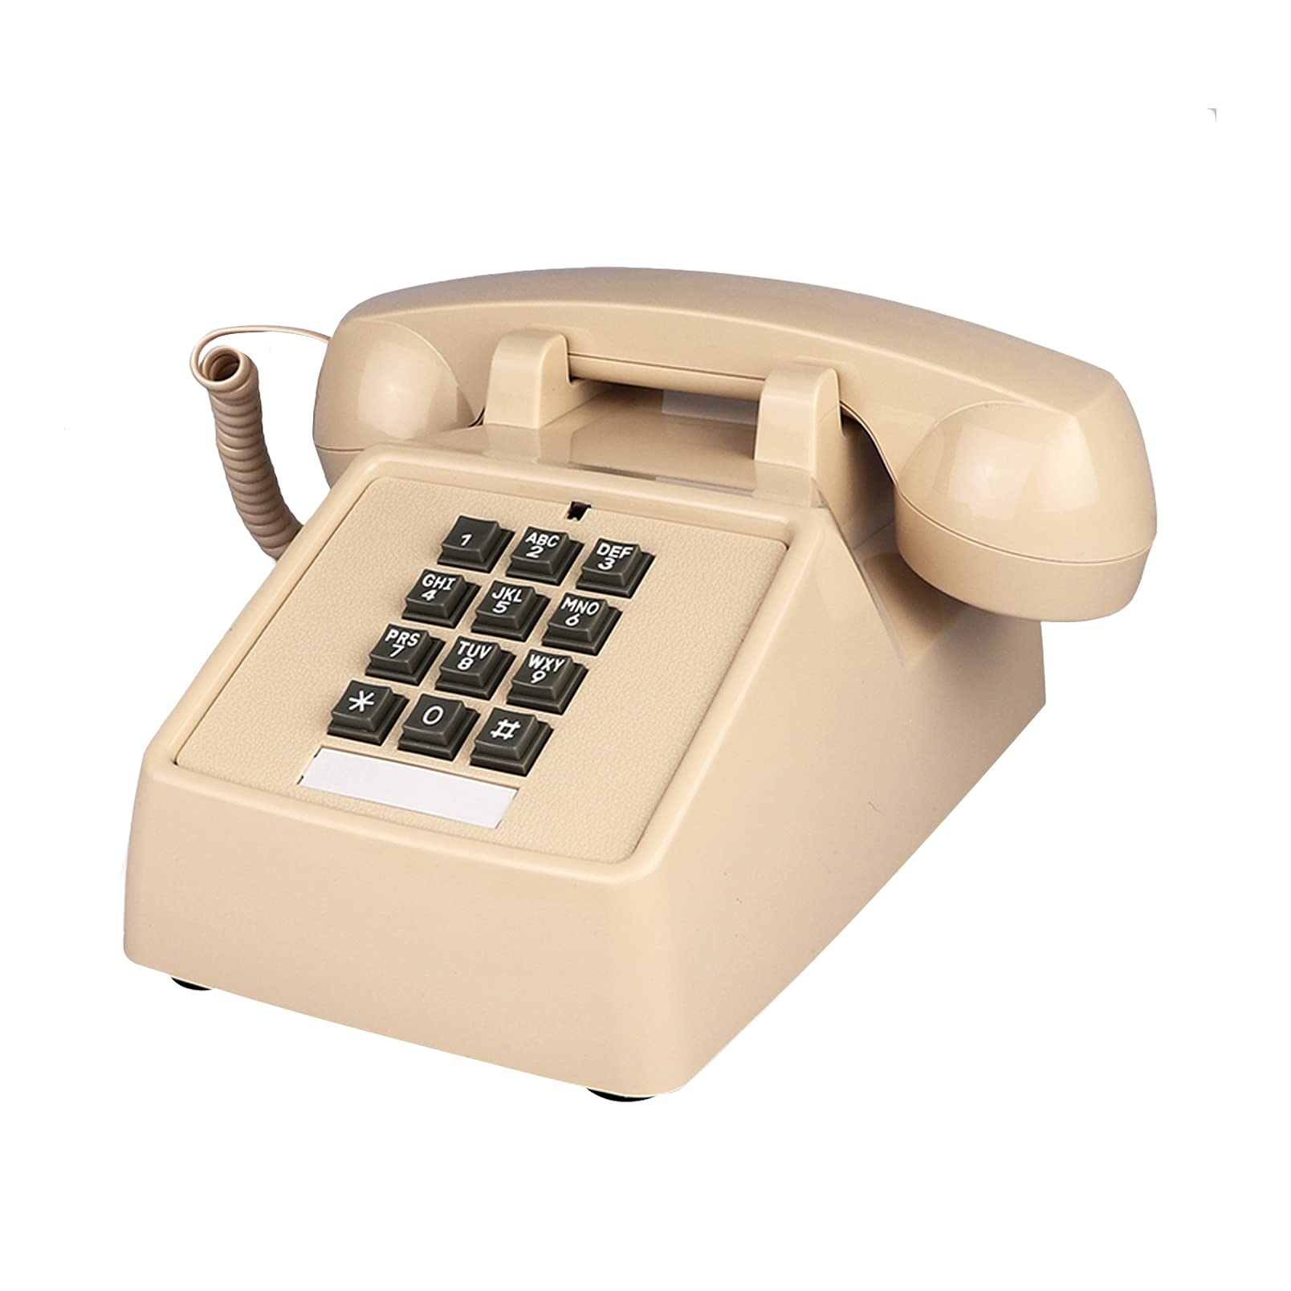


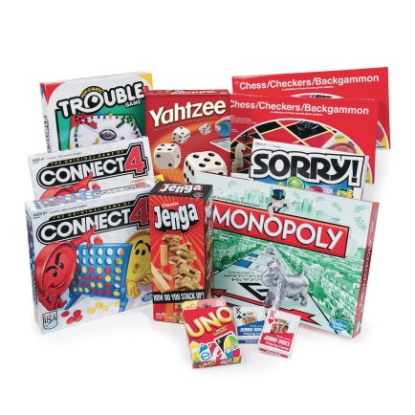

Pirates Cove

Slide 19
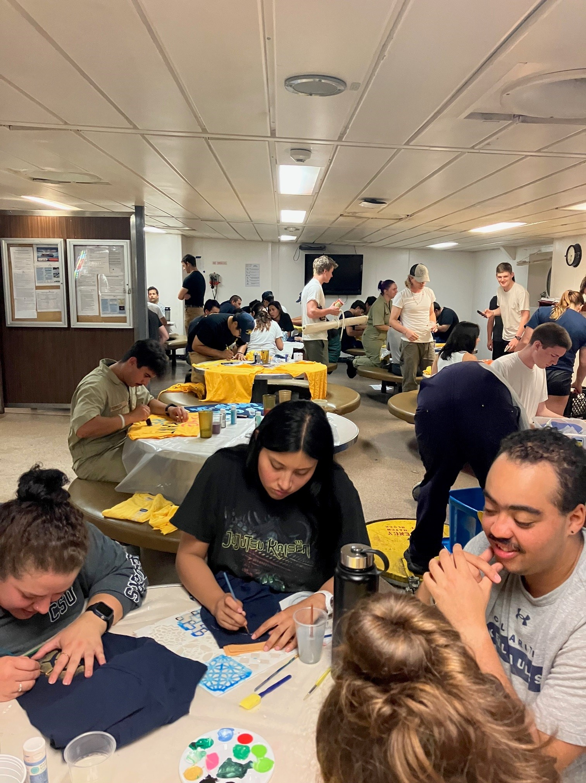
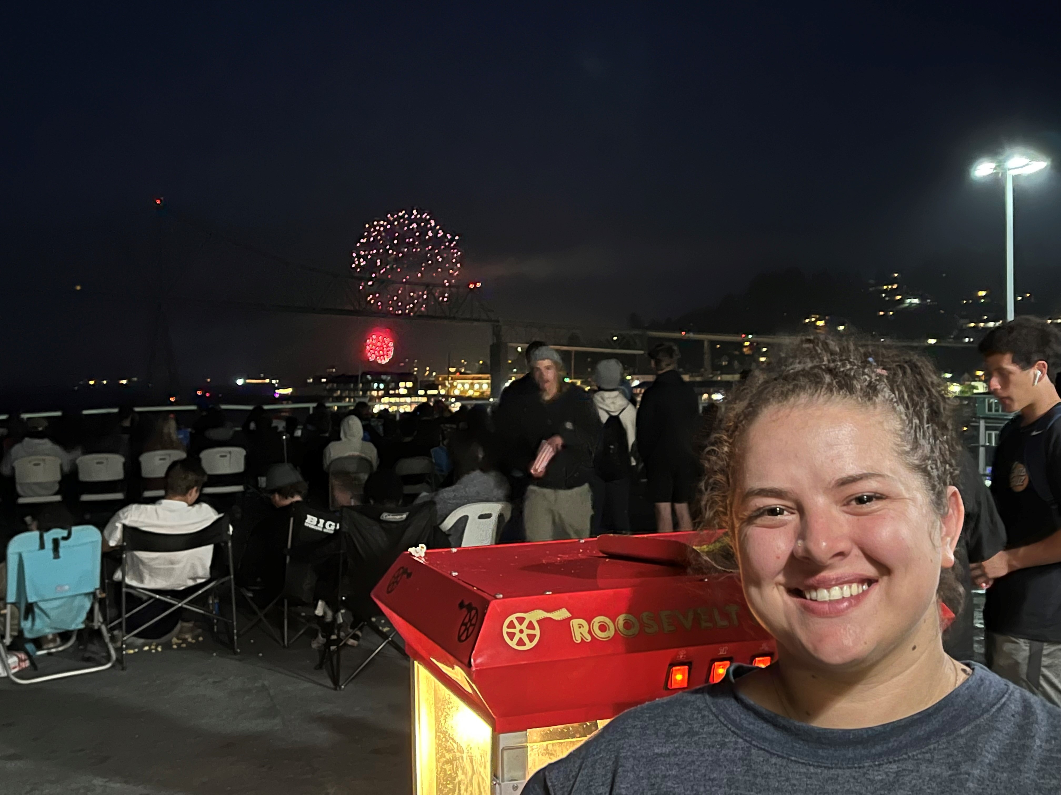
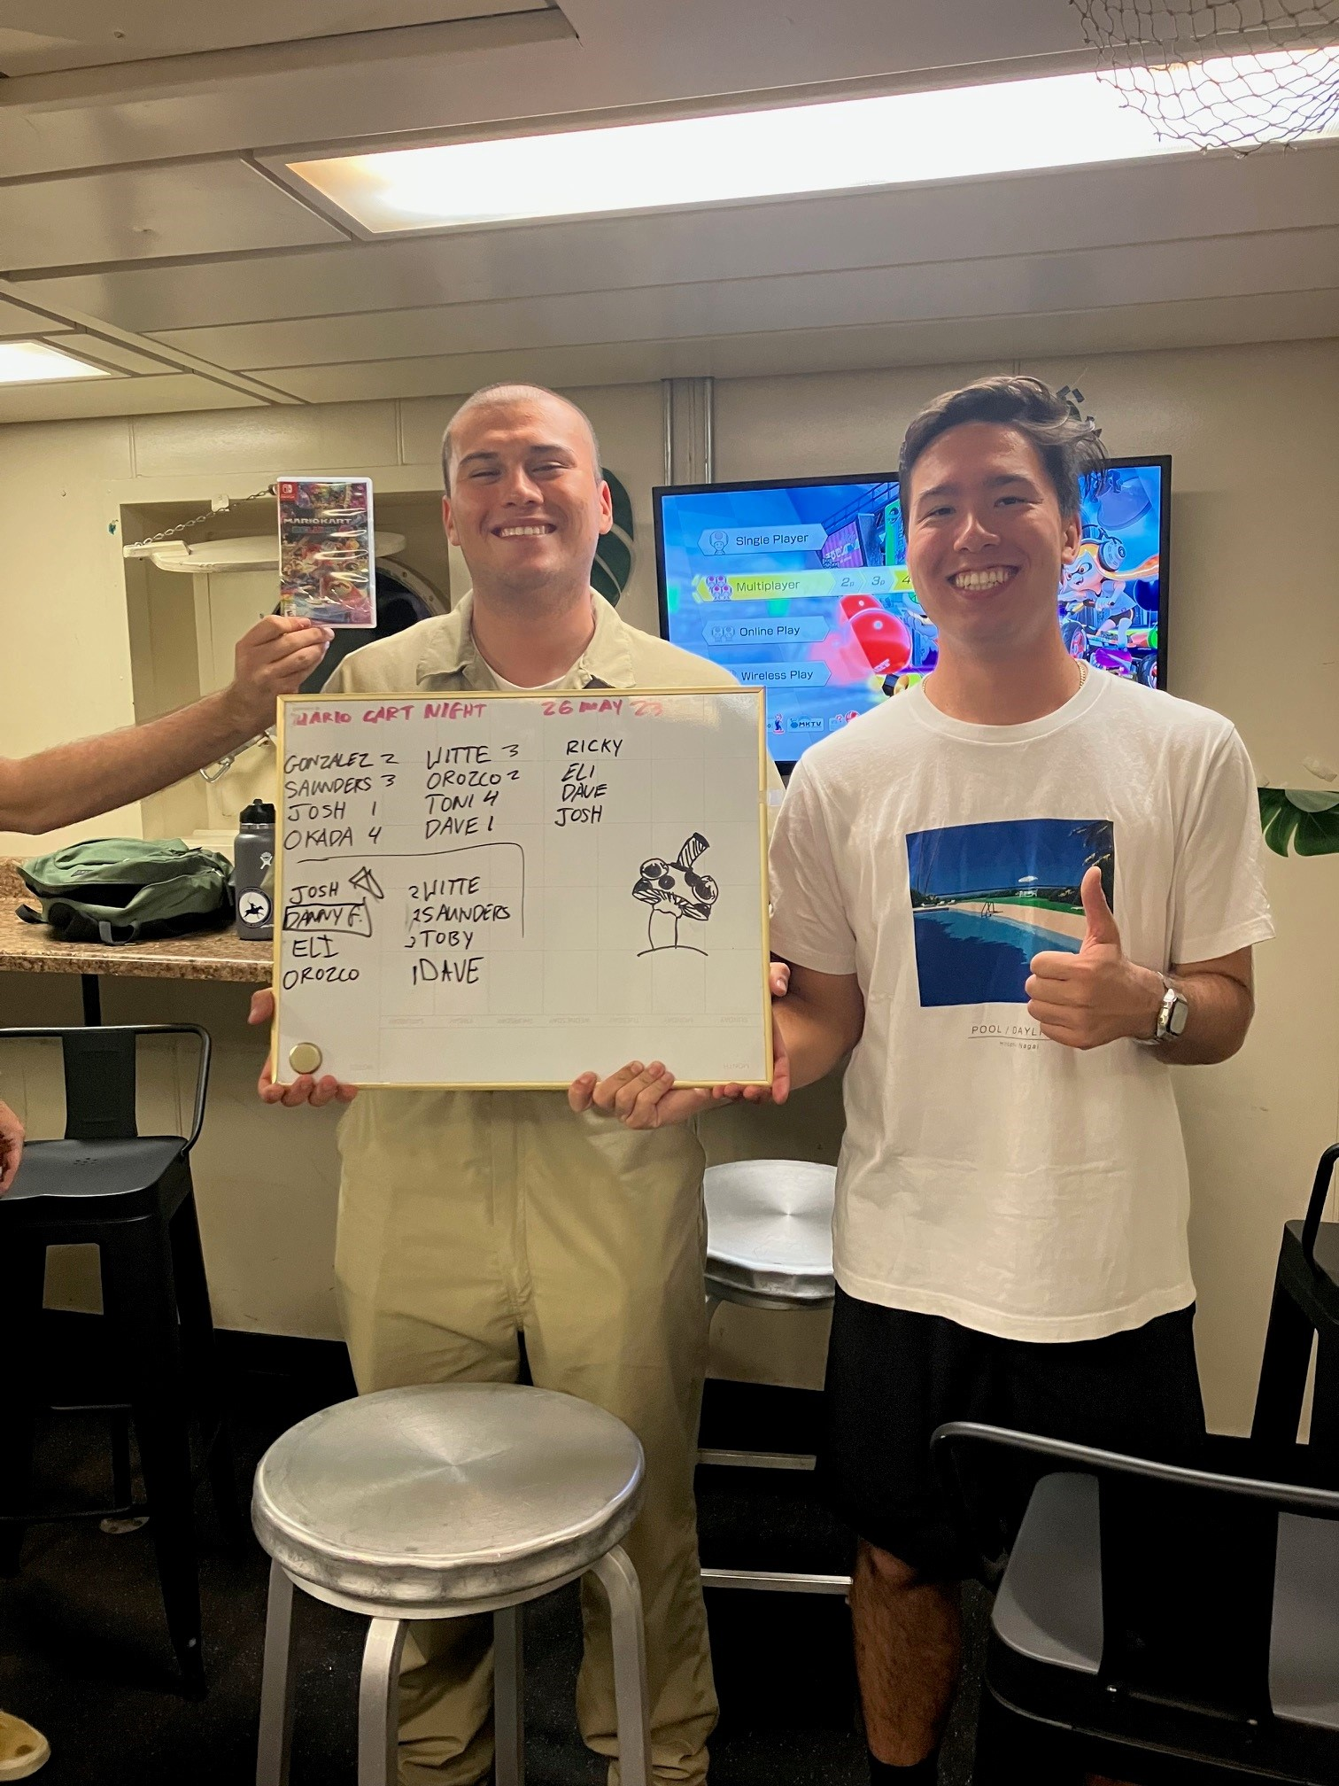
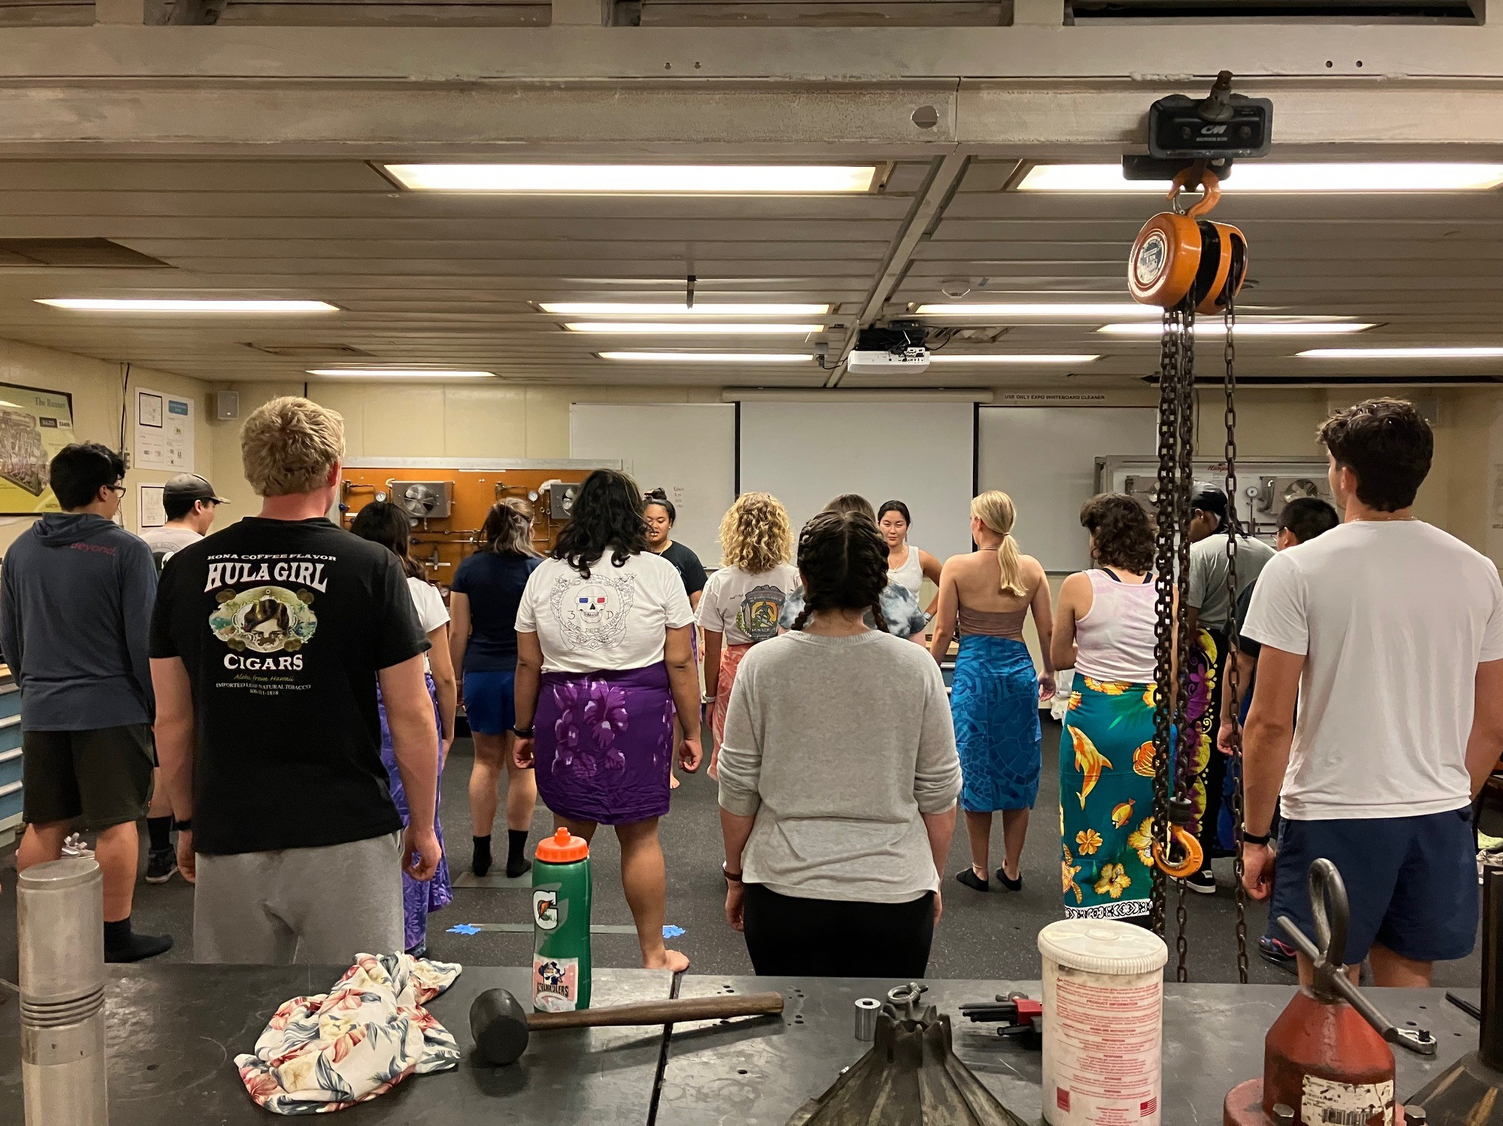
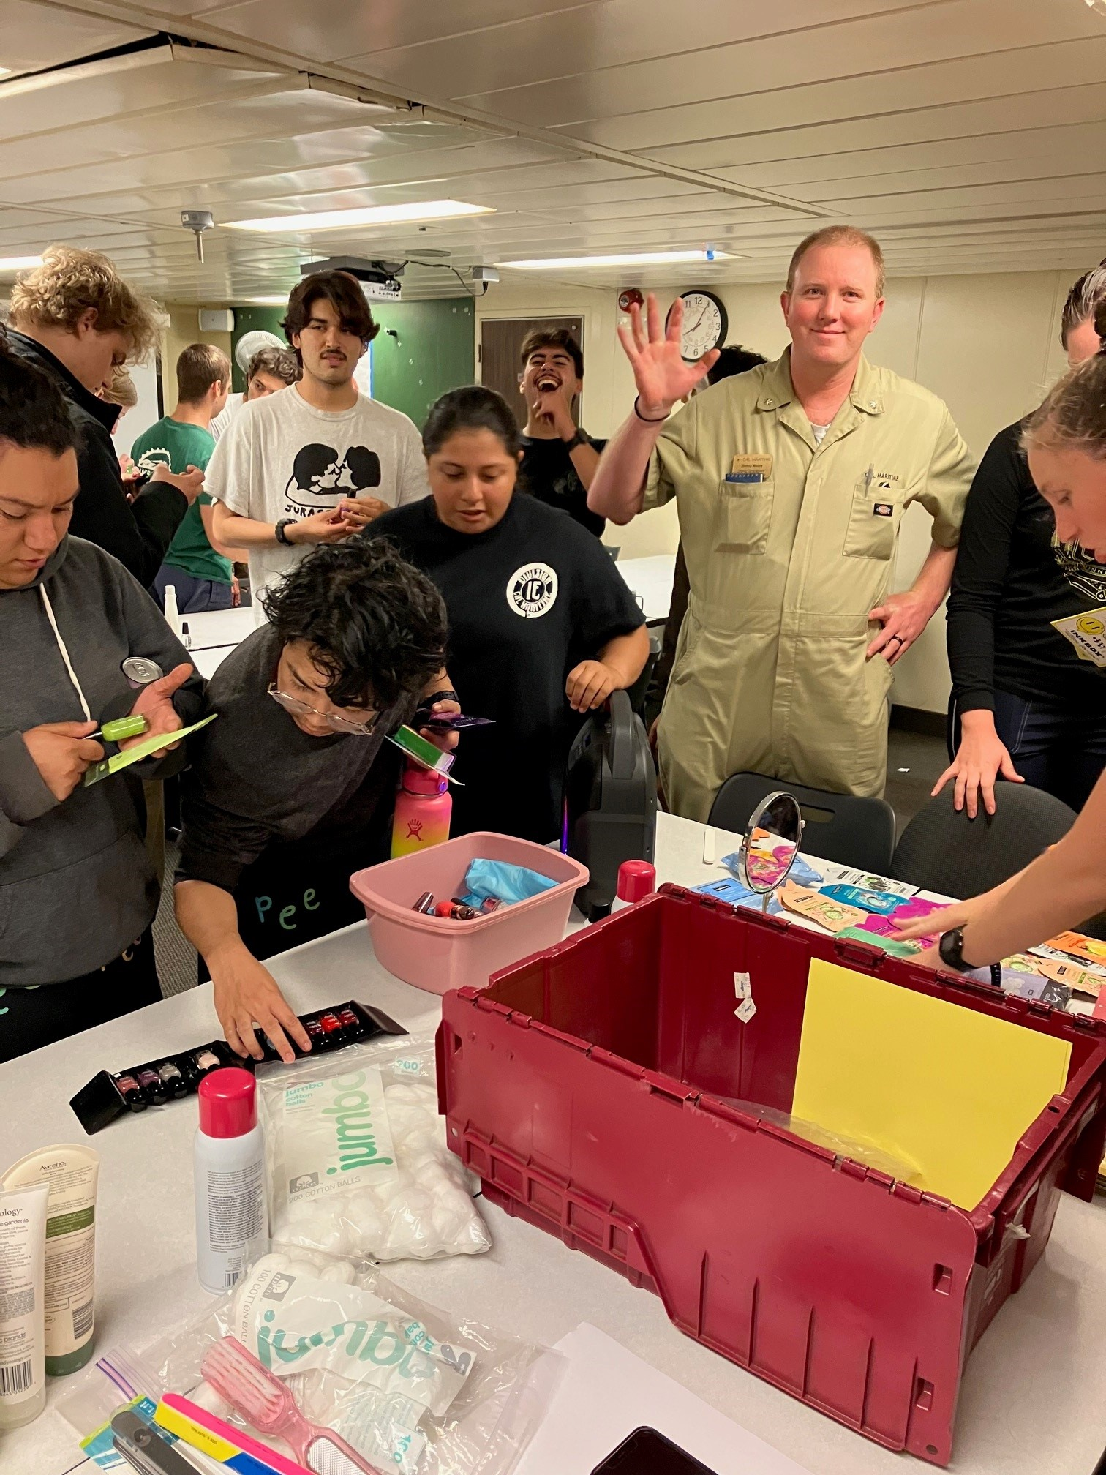
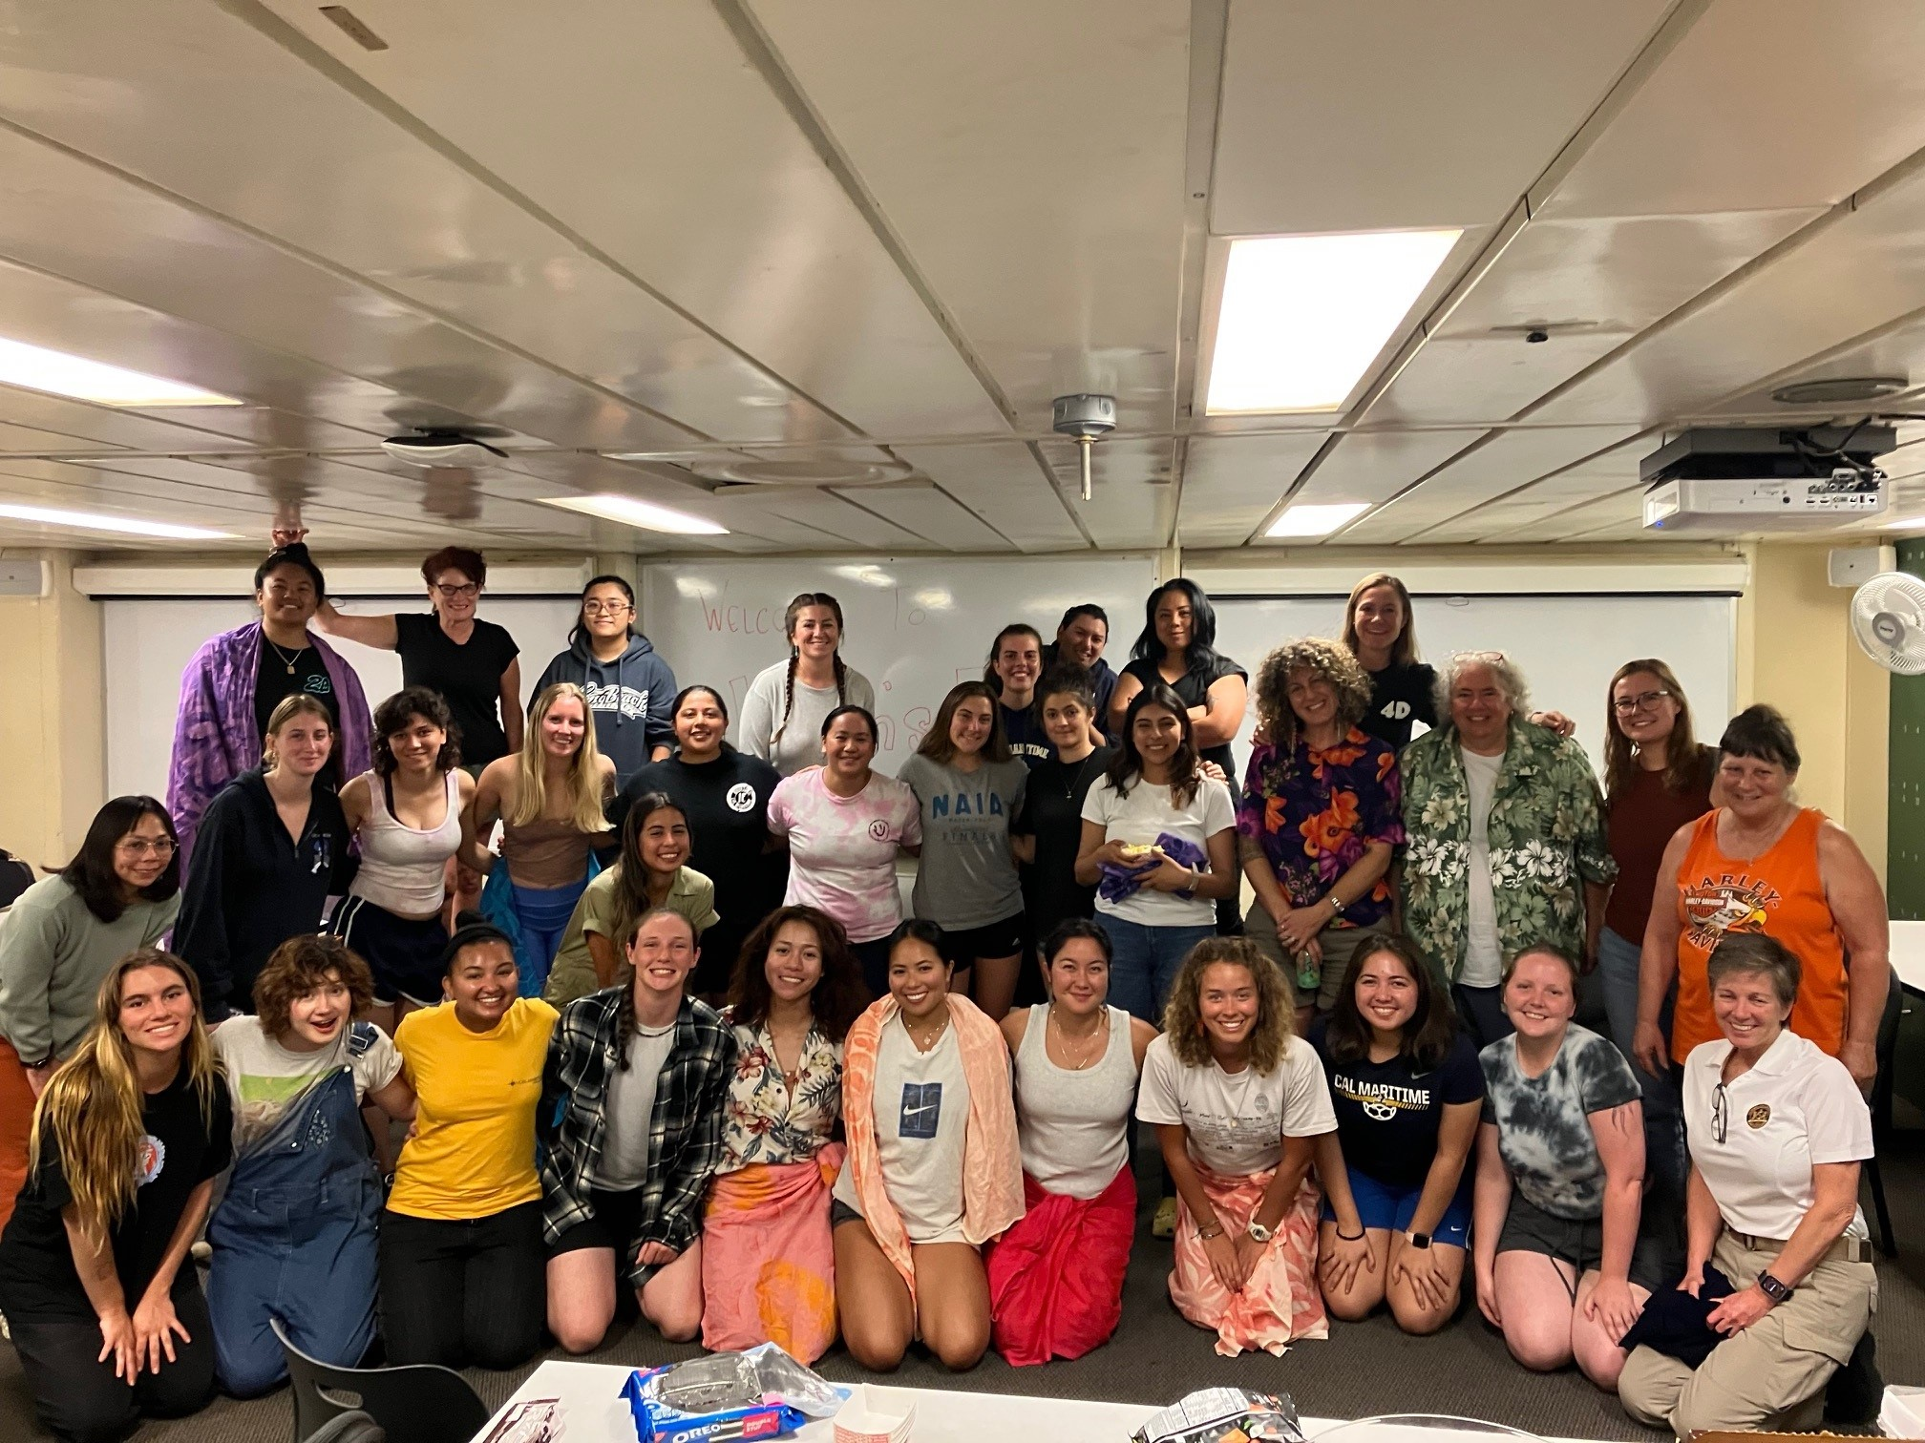
Moral Welfare & Recreation

Slide 20









Slide 21
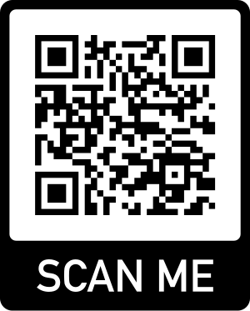
Let Us Know! Ideas for Pirate's Cove & MWR

Slide 22
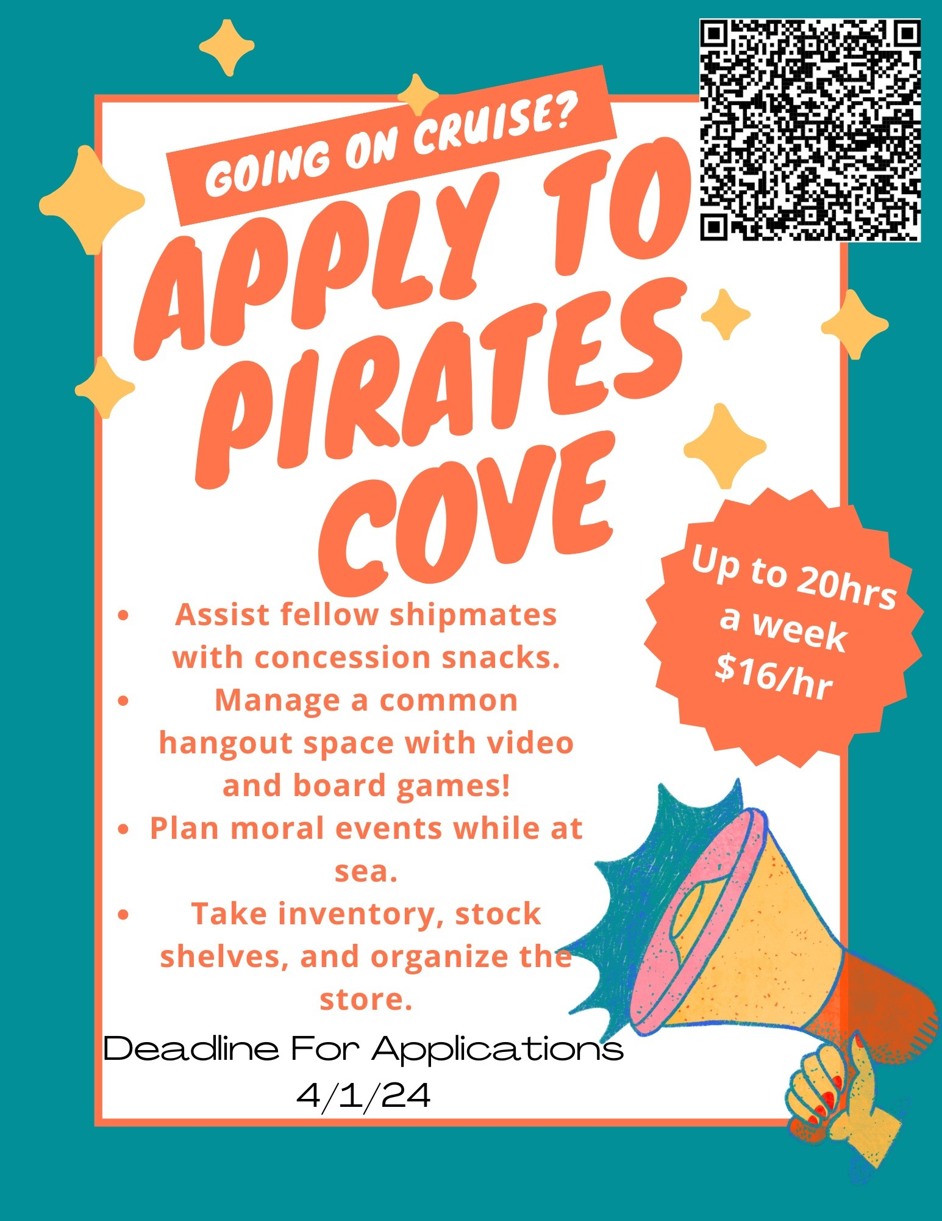
Position can be found on
CSUM HR webpage!

Slide 23
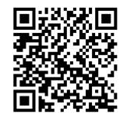
2024 TSGB Cruise Handbook
Be on the Lookout for the
2024 TSGB Cruise Handbook.
All policies, procedures, regulations per Cruise Handbook, and TSGB SMS/ISM apply throughout the entirety of Cruise.
All Financial Aid questions:
Contact:
financialaid@csum.edu
By Phone: (707) 654-1287
Director: Saul Ramirez
saul.ramirez@csum.edu
.

Slide 24
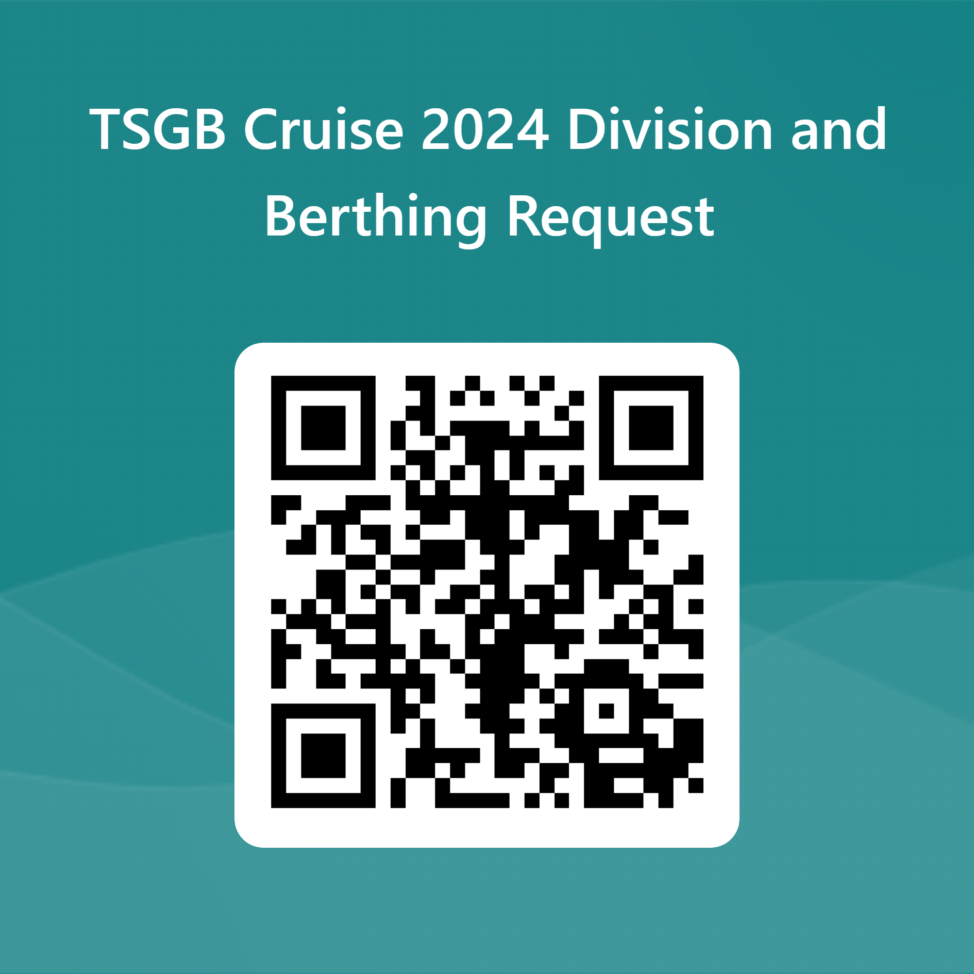

Divisions, Academic Rotations, Berthing Assignments
.
Notes:
Cadets will be assigned to divisions as per the needs of the Academic rotation. We will even out the numbers in the Divsions for Cruise. Everyone please scan this QR code to ensure you accounted for today.
TSGB Ship Staff update: TSGB Cadet Chief Mate Ryan Madden. Deck interviews coming shortly.
TSGB Cadet Chief Engineer interviews occurring now.
Berthing assignments will be made by the TSGB Ship and Cadet staff
Clean Sweep and sanitary inspections will be held daily.1600-1630 Clean Sweep daily. TSGB Cadet Ship staff will be running berthing inspections during this time. Female and Accomodation berthing spaces will be inspected by a specialized team. Captain’s berthing walk throughs are weekly.

Slide 25
Thank You!
.
The next Cruise meeting is scheduled for April 11th, 2024 from 1100-1200 in Rizza.
Stay updated on the TSGB Cruise Website below:
https://www.csum.edu/tsgb-summer-sea-term/
Notes:
Cadets will be assigned to divisions as per the needs of the Academic rotation. We will even out the numbers in the Divsions for Cruise. Everyone please scan this QR code to ensure you accounted for today.
TSGB Ship Staff update: TSGB Cadet Chief Mate Ryan Madden. Deck interviews coming shortly.
TSGB Cadet Chief Engineer interviews occurring now.
Berthing assignments will be made by the TSGB Ship and Cadet staff
Clean Sweep and sanitary inspections will be held daily.1600-1630 Clean Sweep daily. TSGB Cadet Ship staff will be running berthing inspections during this time. Female and Accomodation berthing spaces will be inspected by a specialized team. Captain’s berthing walk throughs are weekly.

